Slide 1


5 Resources and Ideas

Slide 2
Resource 1:
Maths HKO
mathshko.com

Slide 3
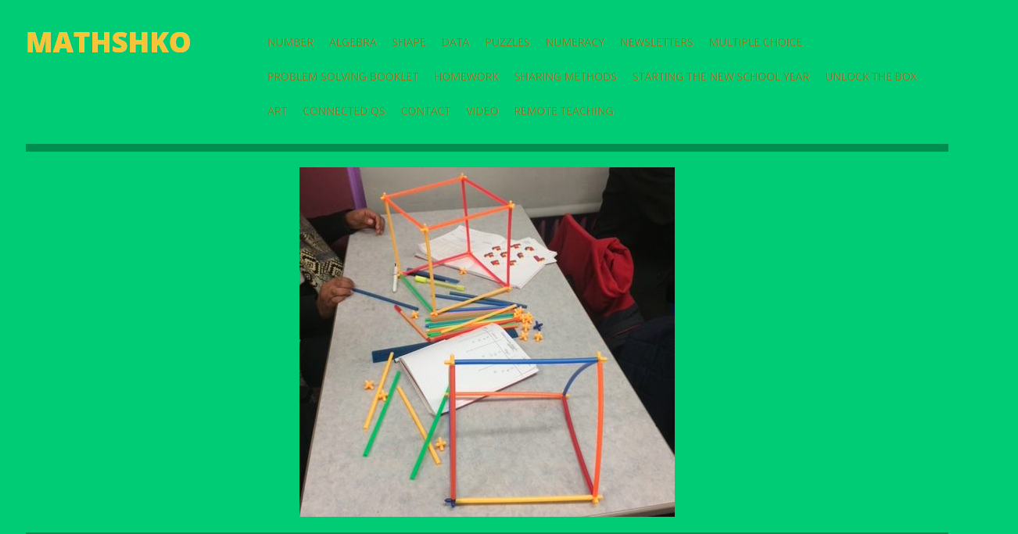

Slide 4
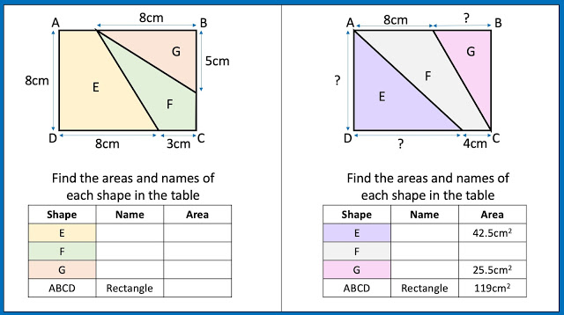

Slide 5
Resource 2:
Free CPD
Me ☺
craigbarton.podia.com

Slide 6
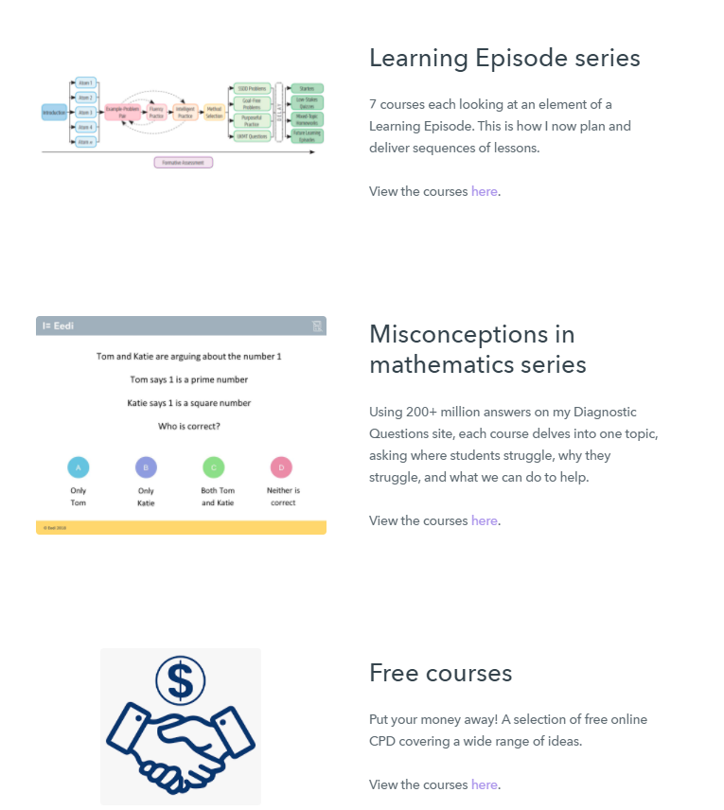

Slide 7
Resource 3:
Maths White Board
mathswhiteboard.com

Slide 8
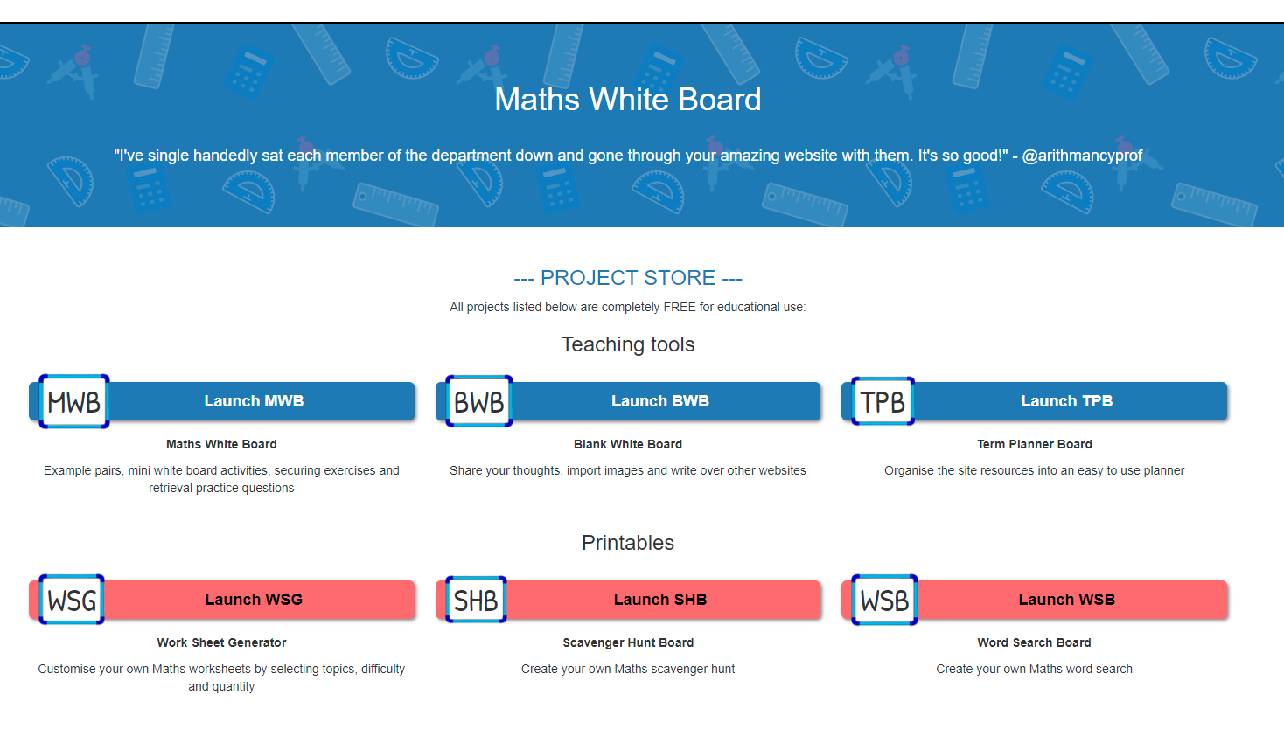

Slide 9
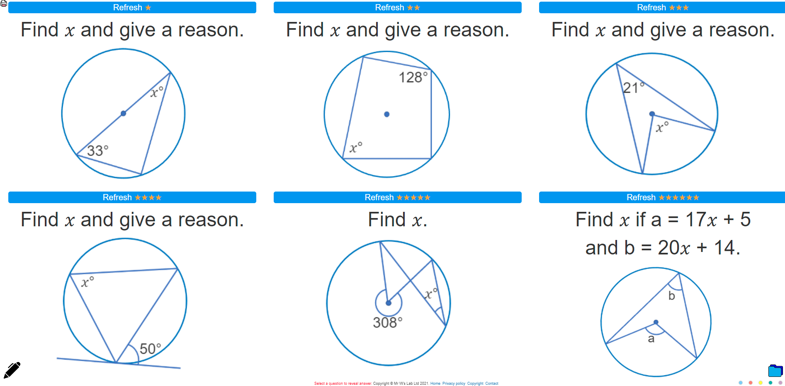

Slide 10
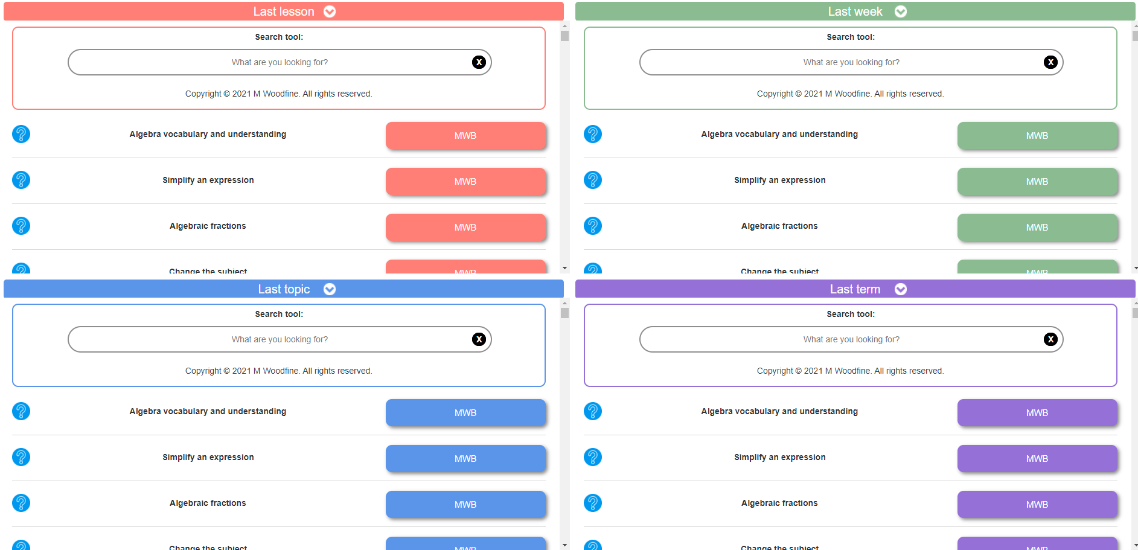

Slide 11
Resource 4:
Purposeful Maths
purposefulmaths.com

Slide 12
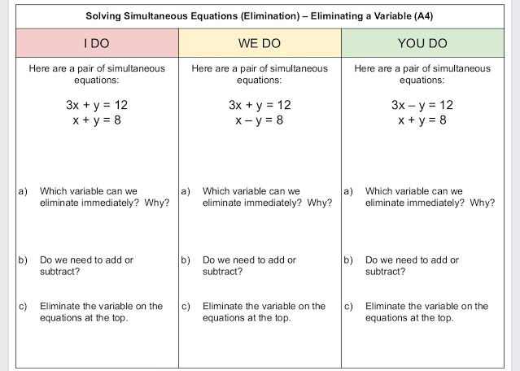

Slide 13
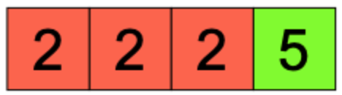
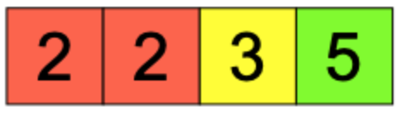
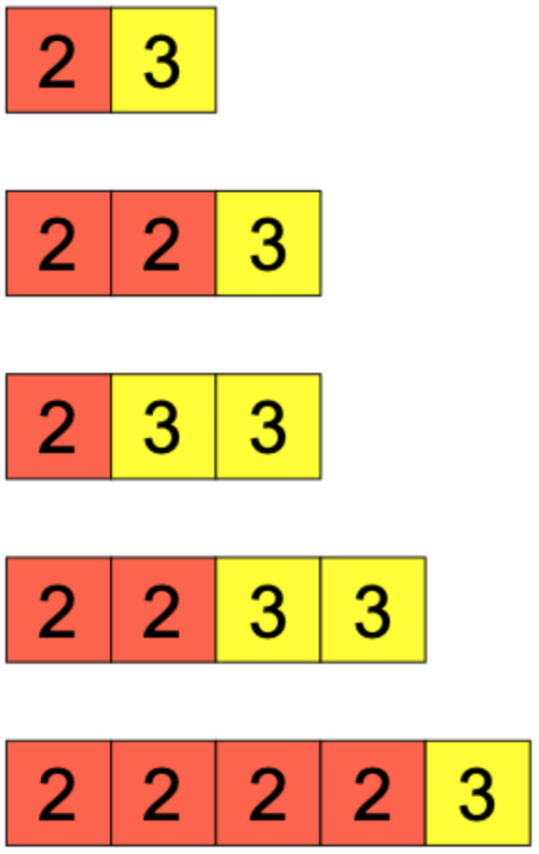
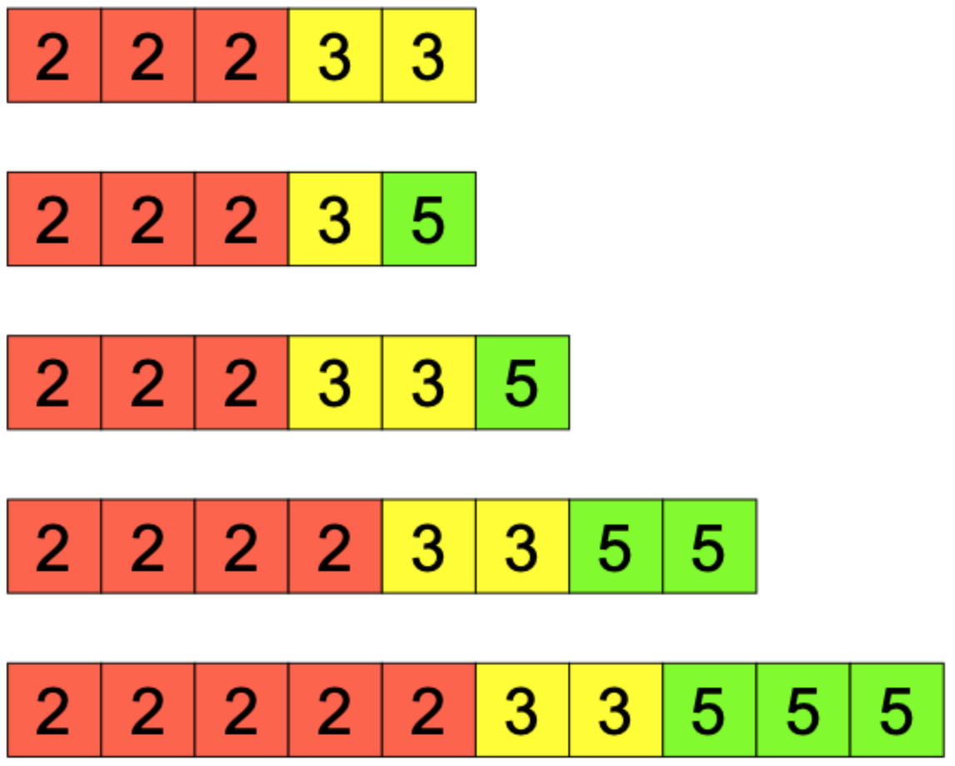
Using Prime Factor Tiles
I DO | WE DO | YOU DO
A number is represented using the prime factor tiles below: What is the number? Write the number as a product of prime factors in index form. | A number is represented using the prime factor tiles below: What is the number? Write the number as a product of prime factors in index form. | For each of the representations below, write down: The number it represents The number as a product of prime factors in index form

Slide 14
Resource 5:
Year 7 Checkpoints
ncetm.org.uk/classroom-resources/checkpoints

Slide 15
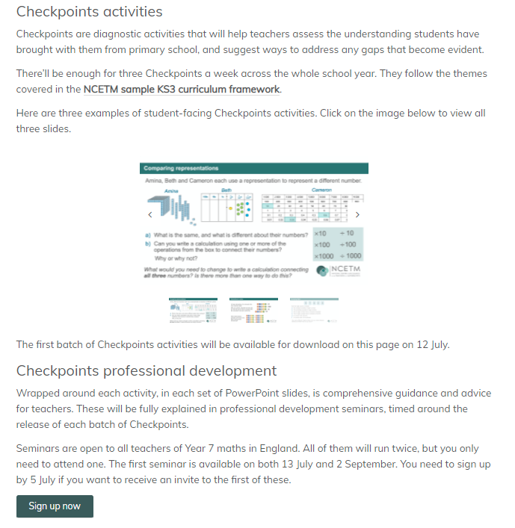

Slide 16
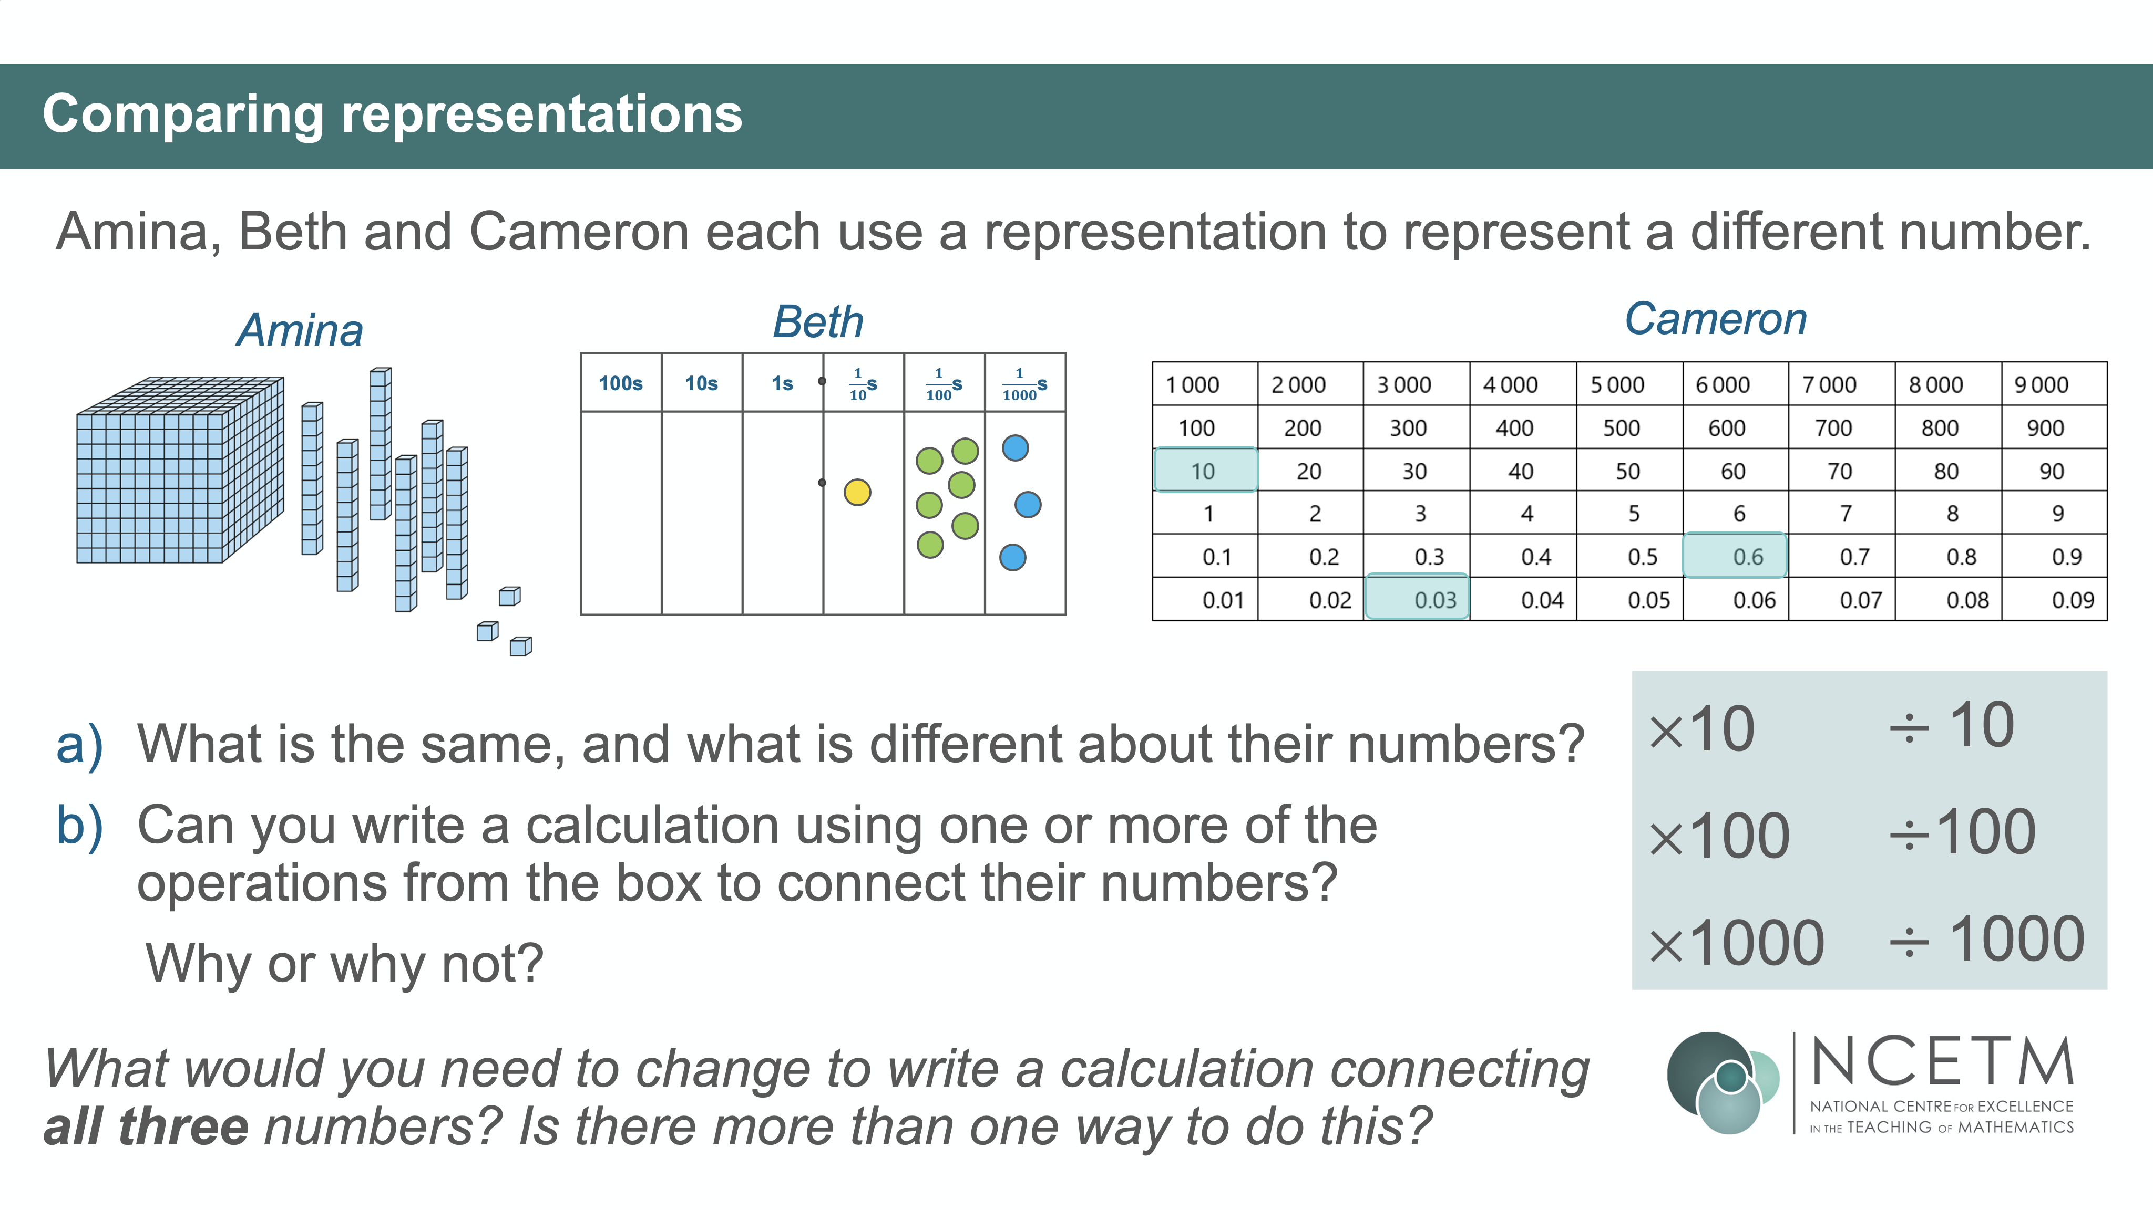

Slide 17
5 Resources and Ideas

