Slide 1


5 Resources and Ideas

Slide 2
Resource 1:
DQaDay
Me ☺
www.dqaday.com

Slide 3
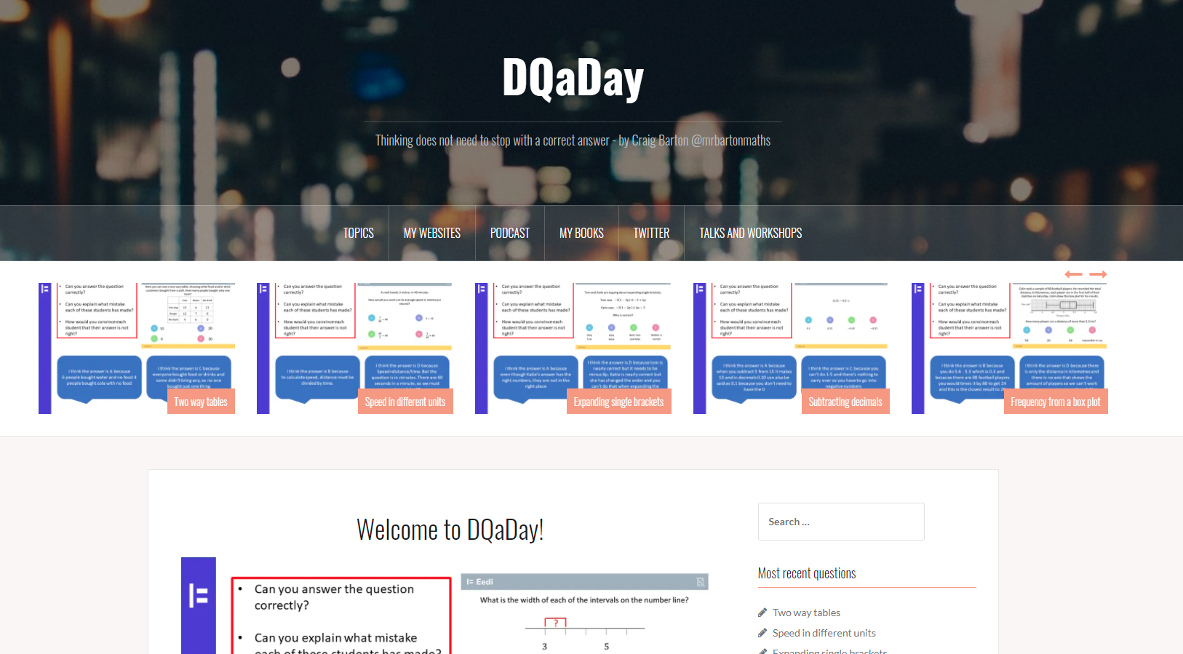

Slide 4
Resource 2:
Maths HKO
mathshko.com

Slide 5
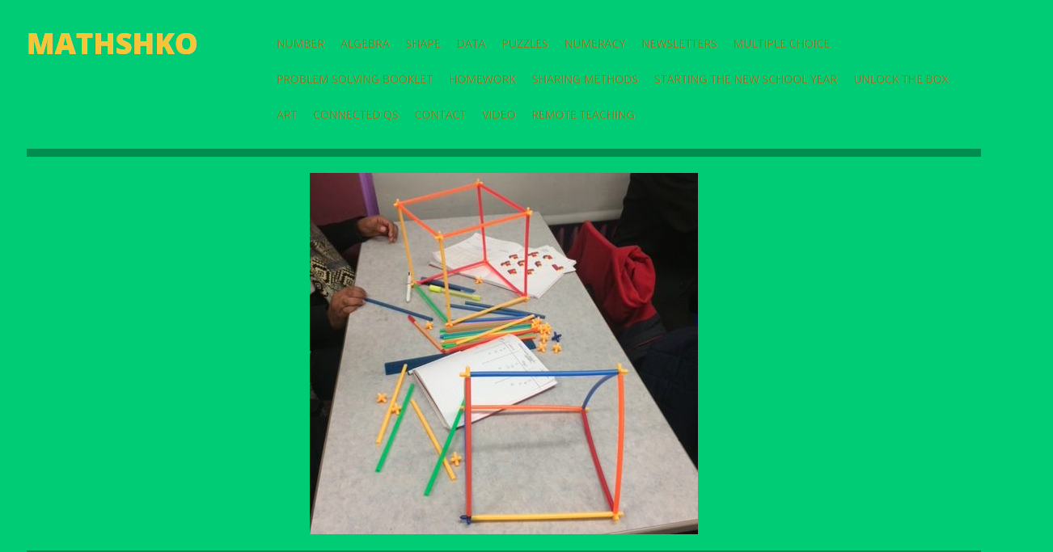

Slide 6
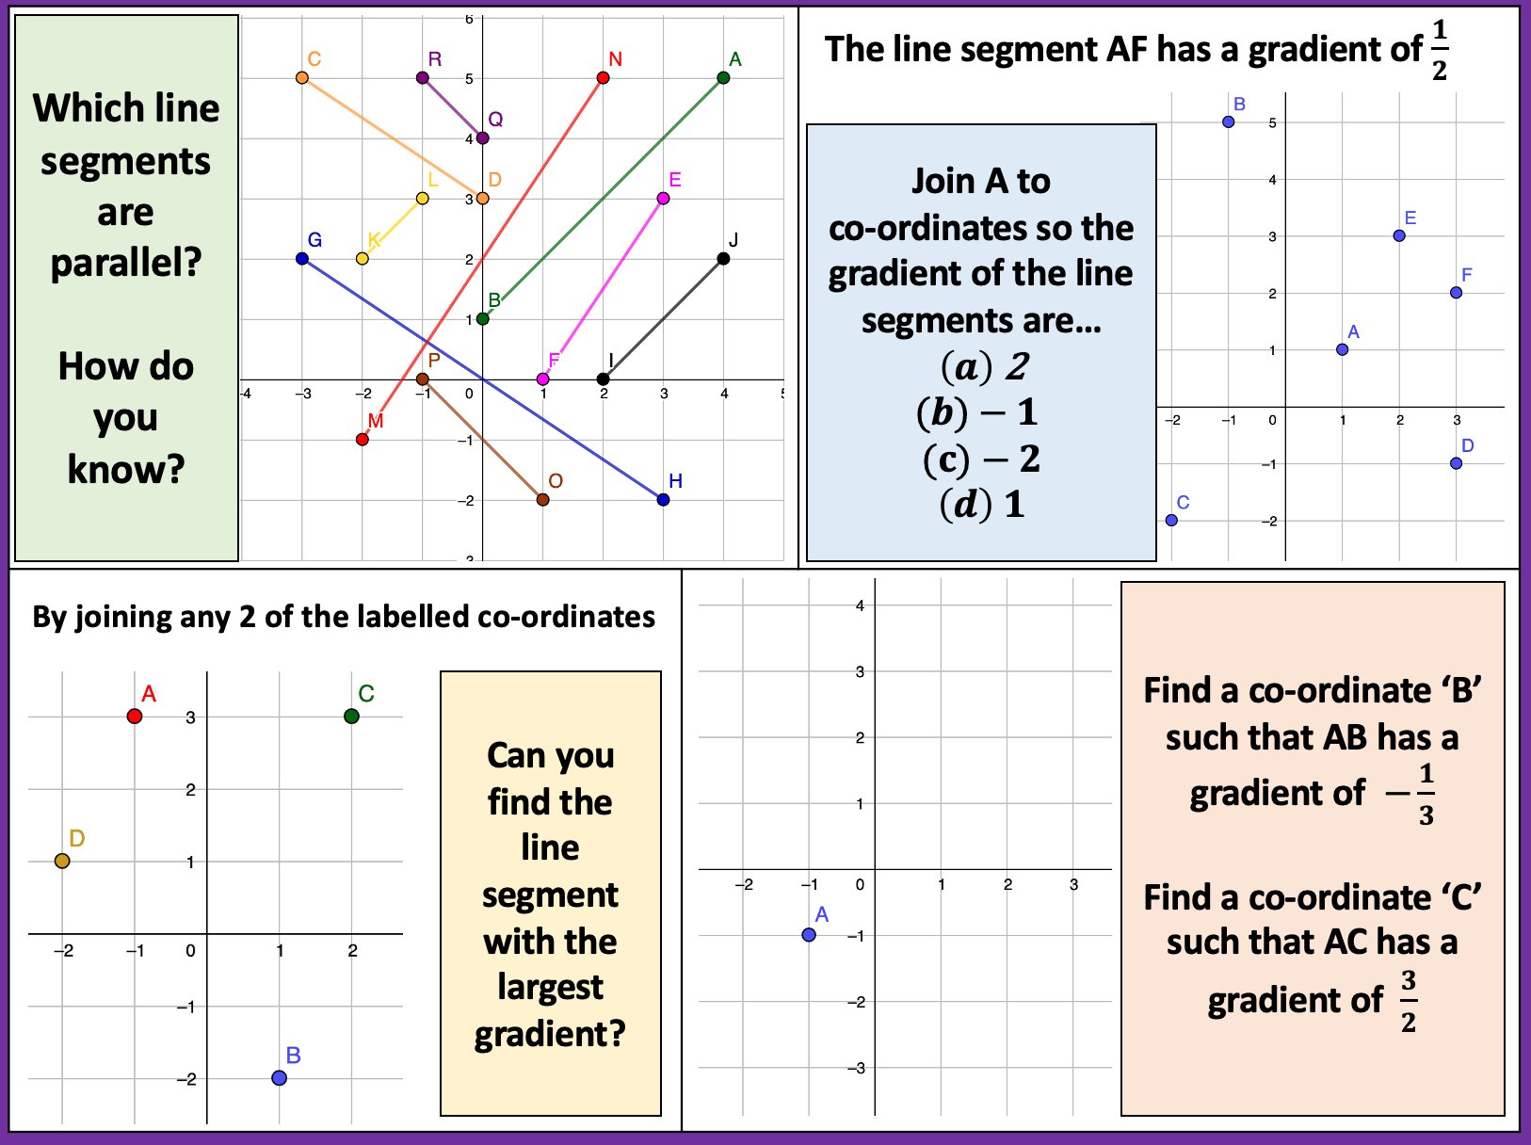

Slide 7
Resource 3:
Curriculum booklets
https://startingpointsmaths.com/curriculum-booklets/

Slide 8
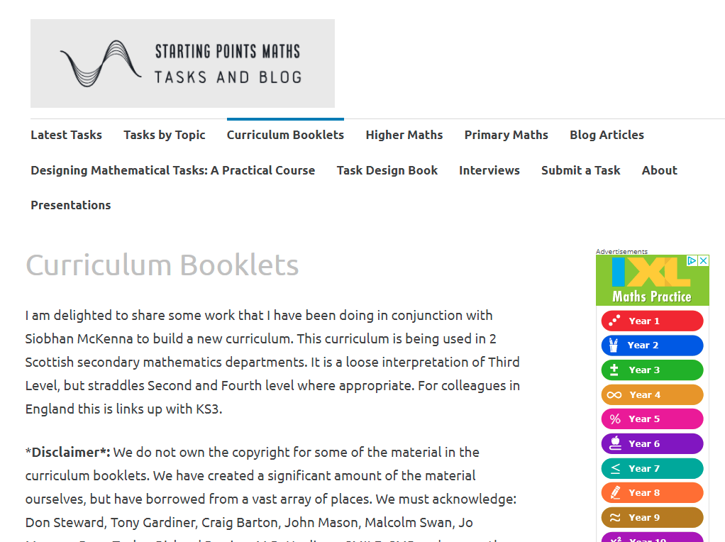

Slide 9
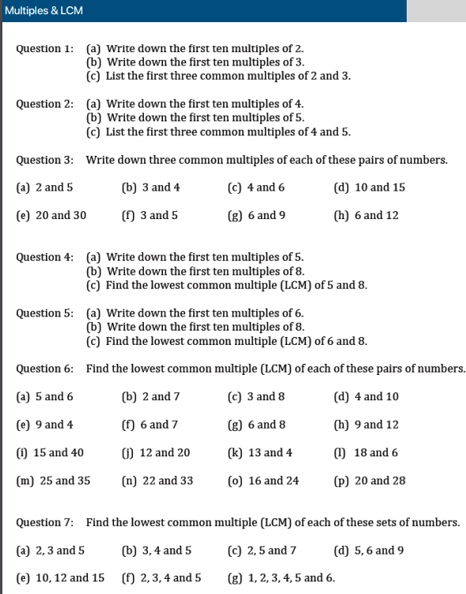

Slide 10
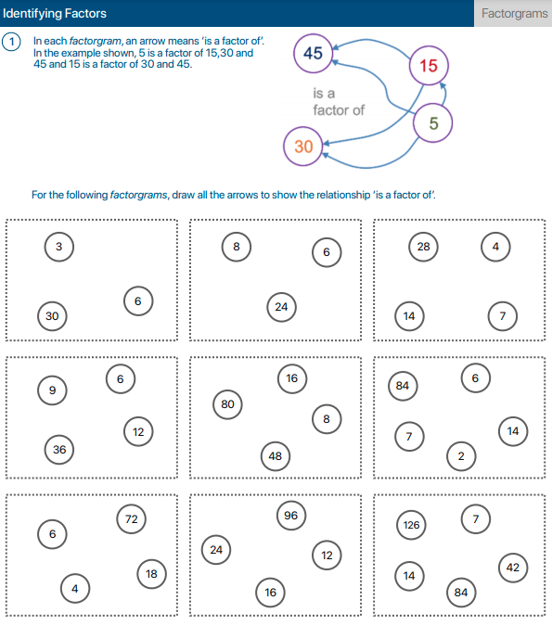

Slide 11
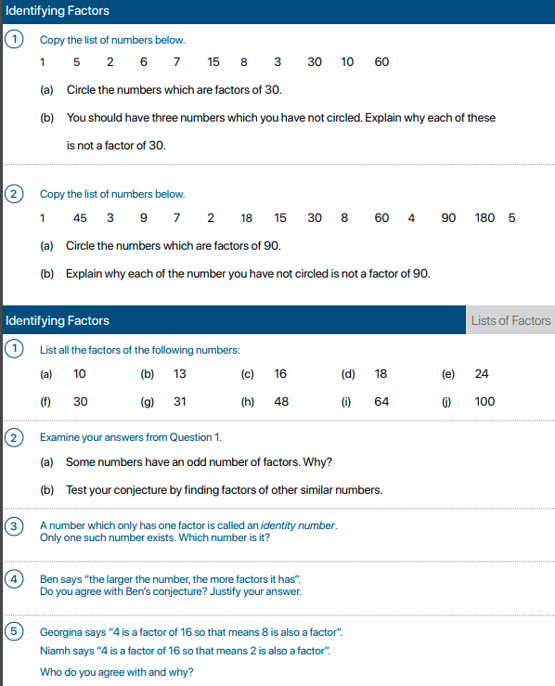

Slide 12
Resource 4:
Mr Coward Maths
mrcowardmaths.wixsite.com/website

Slide 13


Slide 14
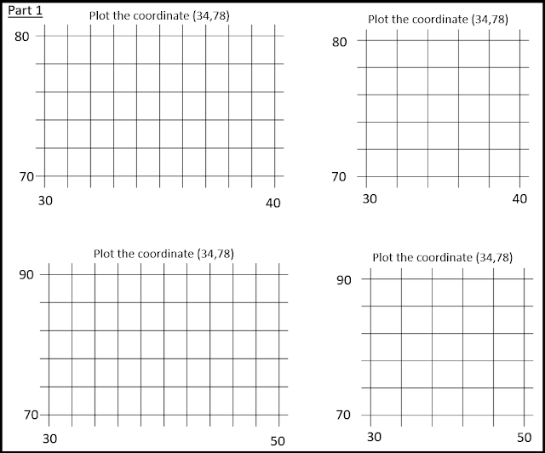

Slide 15
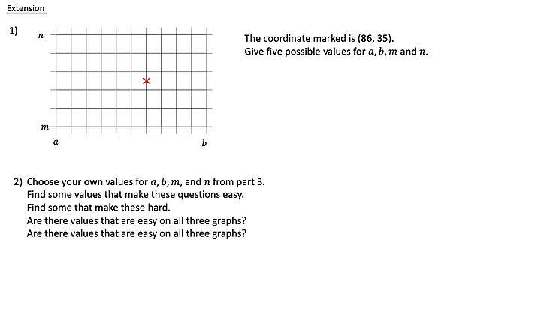

Slide 16
Resource 5:
My podcast
http://www.mrbartonmaths.com/podcast/

Slide 17
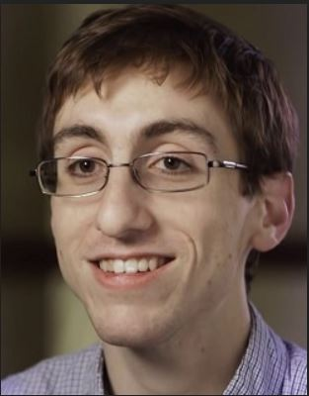


Micahel Pershan
Doug Lemov

Slide 18
5 Resources and Ideas

