Slide 1

Bolton English Hub
Tuesday, 18th January 2021
2.30pm – 3.30/4.00pm

Slide 2
Gerry Reynolds
Assistant Headteacher
Mount St Joseph Catholic School
Introductions:

Slide 3
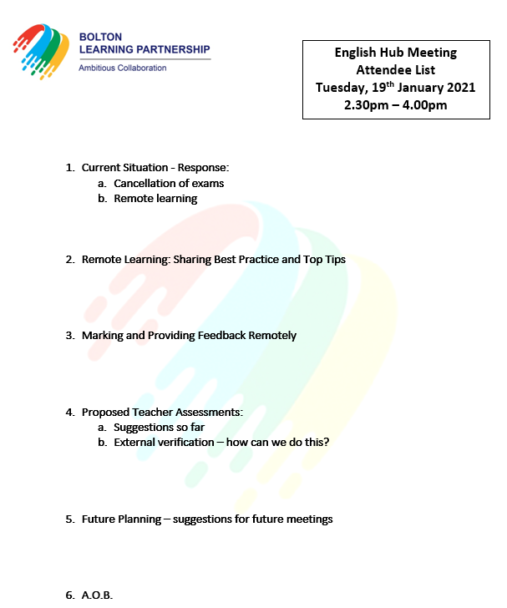

Slide 4

1. The Current Situation: a. Changes to the 2021 GCSE examinations
Key Discussion Topic

Slide 5



Slide 6


Slide 7
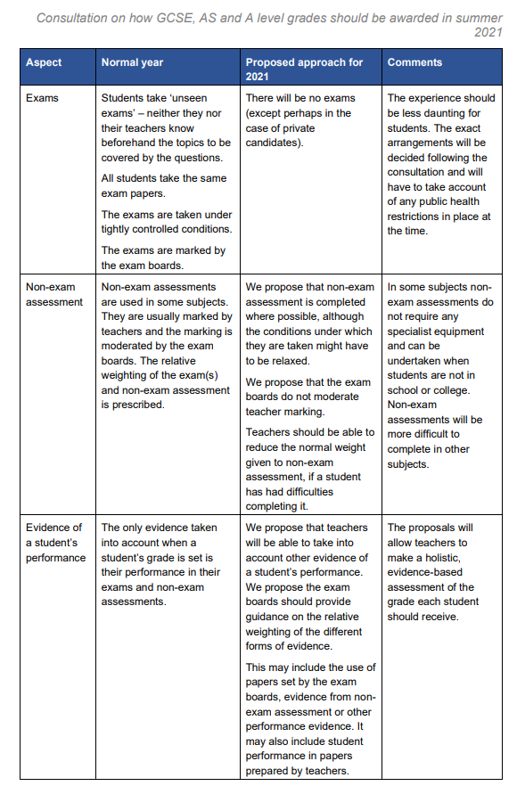
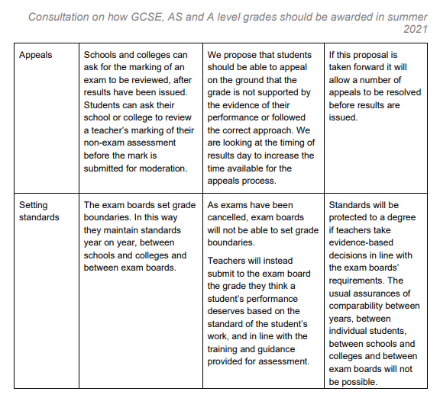

Slide 8
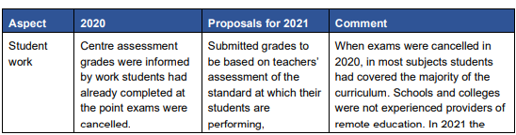
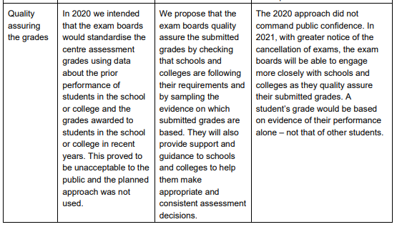
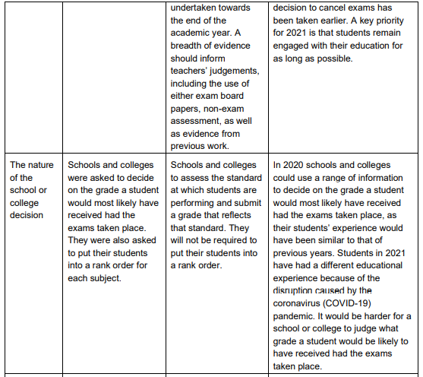


Slide 9




Slide 10
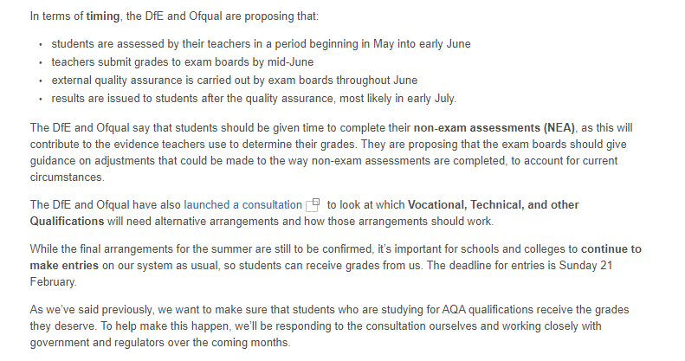


Slide 11
1. The Current Situation: b. Remote learning
Key Discussion Topic

Slide 12

2. Remote Learning:
Pedagogy and Strategies for Remote Learning
Sharing Best Practice and Top Tips
Key Discussion Topic
Sharing Best practice

Slide 13

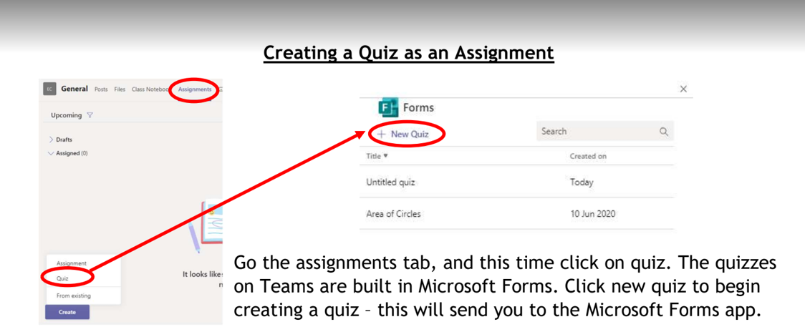
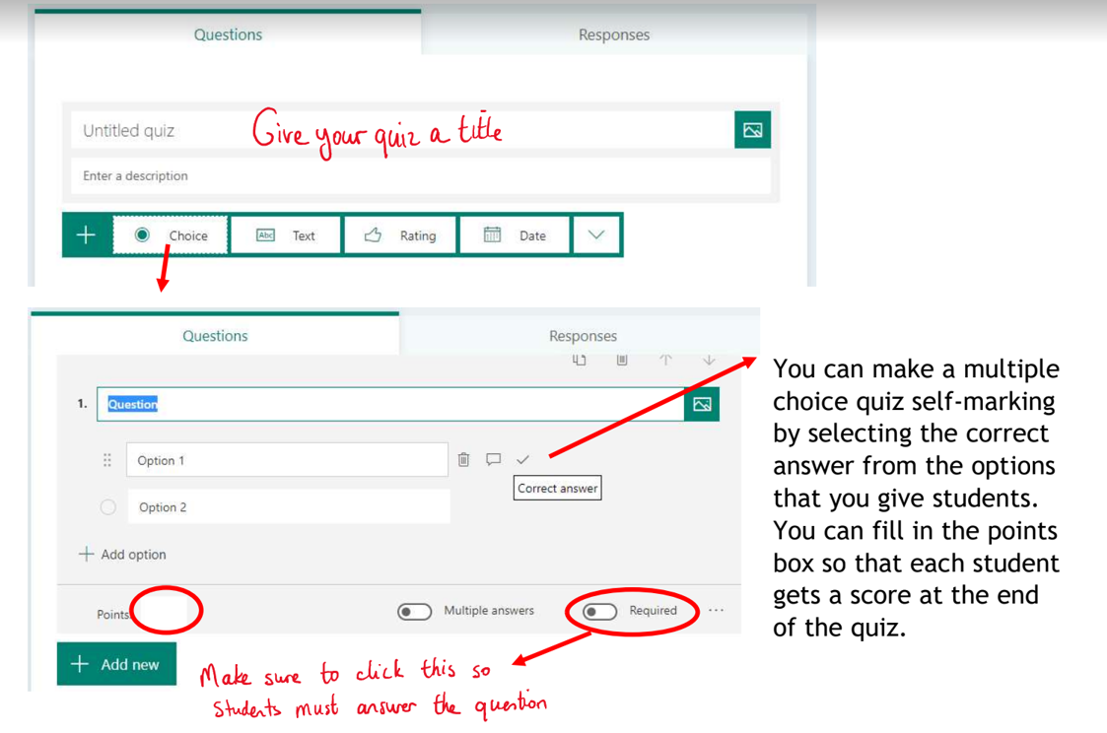
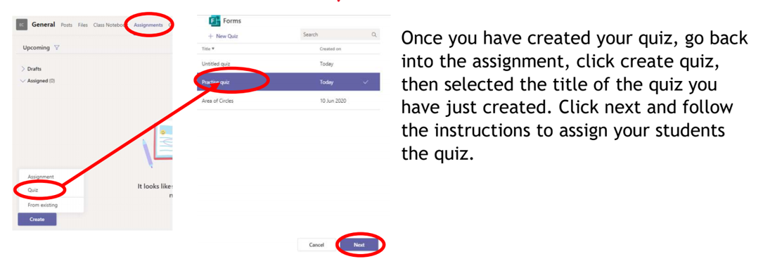
Remote Learning: Key strategy of the week - 18th Jan 2021:
Creating a quiz that can be used during the live lesson!
Please also see attached PDF.

Slide 14

Other resources and ideas . . .

Slide 15
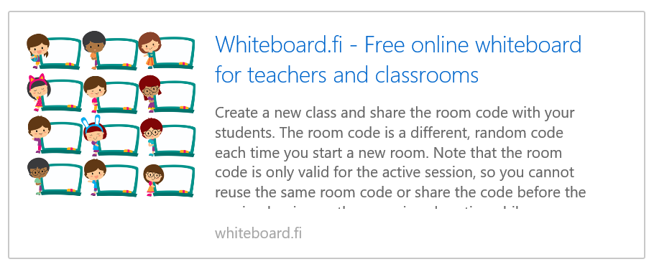

Mini whiteboards for every student – a great way to incorporate AfL:

Slide 16
In the classroom, you were able to project your PowerPoint presentation on to a whiteboard and annotate. On Teams, you can convert your PowerPoint into a PDF, upload it to the Class Notebook, and then annotate to your heart's content.
How to annotate your PowerPoint on Teams during the lesson:

Slide 17

An interesting discussion tool – pupils pre-record their ideas and these are shared in the session:

Slide 18
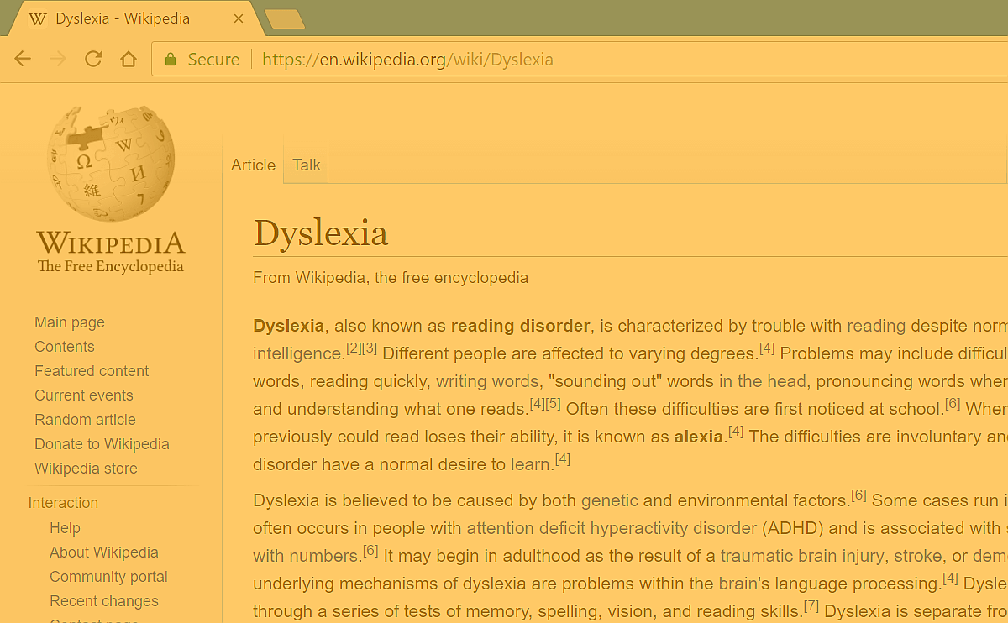
Screen overlays for pupils who need these in class:
 | ColorVeil - Screen color filter and dimmer | Aurelitec Add a color filter over your screen, over any website you visit, and over any program you use. Dim screen brightness, reduce eye strain, and save energy. www.aurelitec.com
https://www.aurelitec.com/colorveil/windows

Slide 19

Interactive puzzles that can be embedded in lessons:
Create Own Puzzles: Online, Free and Interactive! (puzzel.org)

Slide 20
3. Remote Learning:
Marking and Providing Feedback Remotely
Key Discussion Topic
Sharing Best practice

Slide 21
4. Proposed Teacher Assessments: a. Suggestions so far b. External verification – how can we do this?
Key Discussion Topic

Slide 22
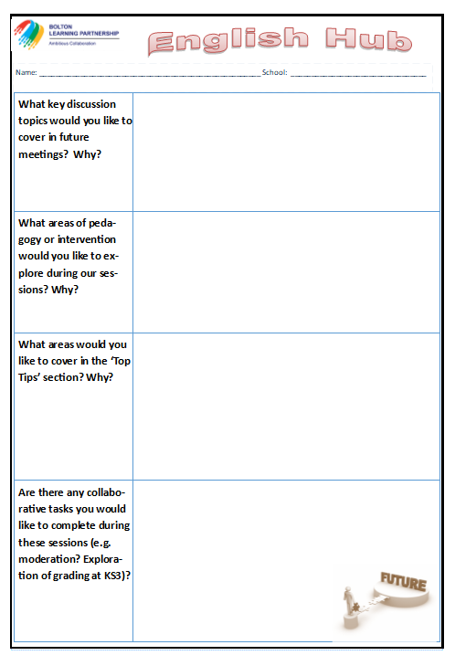

Future Meetings:
Thursday, 18th March 2021
Thursday, 24th June 2021
Future planning:

Slide 23
What would you like to see on the agenda for the rest of this academic year? Think about: • Leadership development • Pedagogy • Interventions | Further opportunities for moderation and standardisation Share strategies based on summer’s results KS3 curriculum Stretch and challenge (HAPs) Engagement of boys Teaching the structure question Effective interventions Pedagogy Discussion Visits from exam boards/ resource providers The chance to discuss successful intervention strategies used with key cohorts such as WBB To hear from colleagues who have made improvements in key areas (boys, writing etc.), unpacking how they have made an impact Further examples of how we engage students in reading Teaching top tips Accuracy of predictions Assessment points Data – PPE tracking and comparison to outcomes Leadership development Curriculum sharing Discussion on interleaving (spacing/ retrieval etc.)

