Slide 1
Supporting Student and Staff Mental Health and Wellbeing
Thursday 21st January

Slide 2

What has our journey been like with our learners?
A relatively straight road of incremental
development over the past 10 years
Appointment of a mentor 14+ years ago
Growth of this service and specialized training our LMP team
Appointment of a manager as the mentors and LSA numbers grow
Safeguarding emerges from child protection and grows rapidly
Tutorial system switches to specialist tutors
High quality pastoral programme and offer emerges and develops

Slide 3
Learning Services Highlights
LSA provision
LMP provision – 6 staff to work with learners on a range of issues
STORM training and other relevant training
All able to triage to safeguarding team
College counsellor – 3 days /week+
High performing Team and the Team undertake professional personal development all the time and train each other and provide key information to all learners

Slide 4
Pastoral highlights
Specialist Progress tutors responsible for learner progress in widest sense. They also deliver study skills and a very detailed and well planned pastoral programme that includes regular content on wellbeing
They deliver VESPA to both year groups – great support to developing learner mental health and resilience
We have specialist external presenters to examine key aspects of learner wellbeing annually, begins in Induction
4 of the team are trained as Mental Health First aiders and we have plans to train the rest this year
Learner engagement and involvement via the student council and curriculum groups and we train learners to be peer mentors

Slide 5
Wider offer for learners
Enrichment weeks and other well being events
Challenges to keep leaners engaged
Skills day
Wellbeing day
Dedicated careers staff
Work experience
Student portal with lots of self help information
Posters for services such as KOOTH in all bathrooms

Slide 6

Our offer to staff
All systems, processes, policy changes have (learner) and staff wellbeing in focus
Weekly bulletin, BITK, which includes staff nominated ‘shout outs’ and staff nominated ‘inspirational quotes’
Yoga, exercise group, crafting
Staff competitions
Staff enrichment
Random acts of kindness
Weekly staff briefing

Slide 7
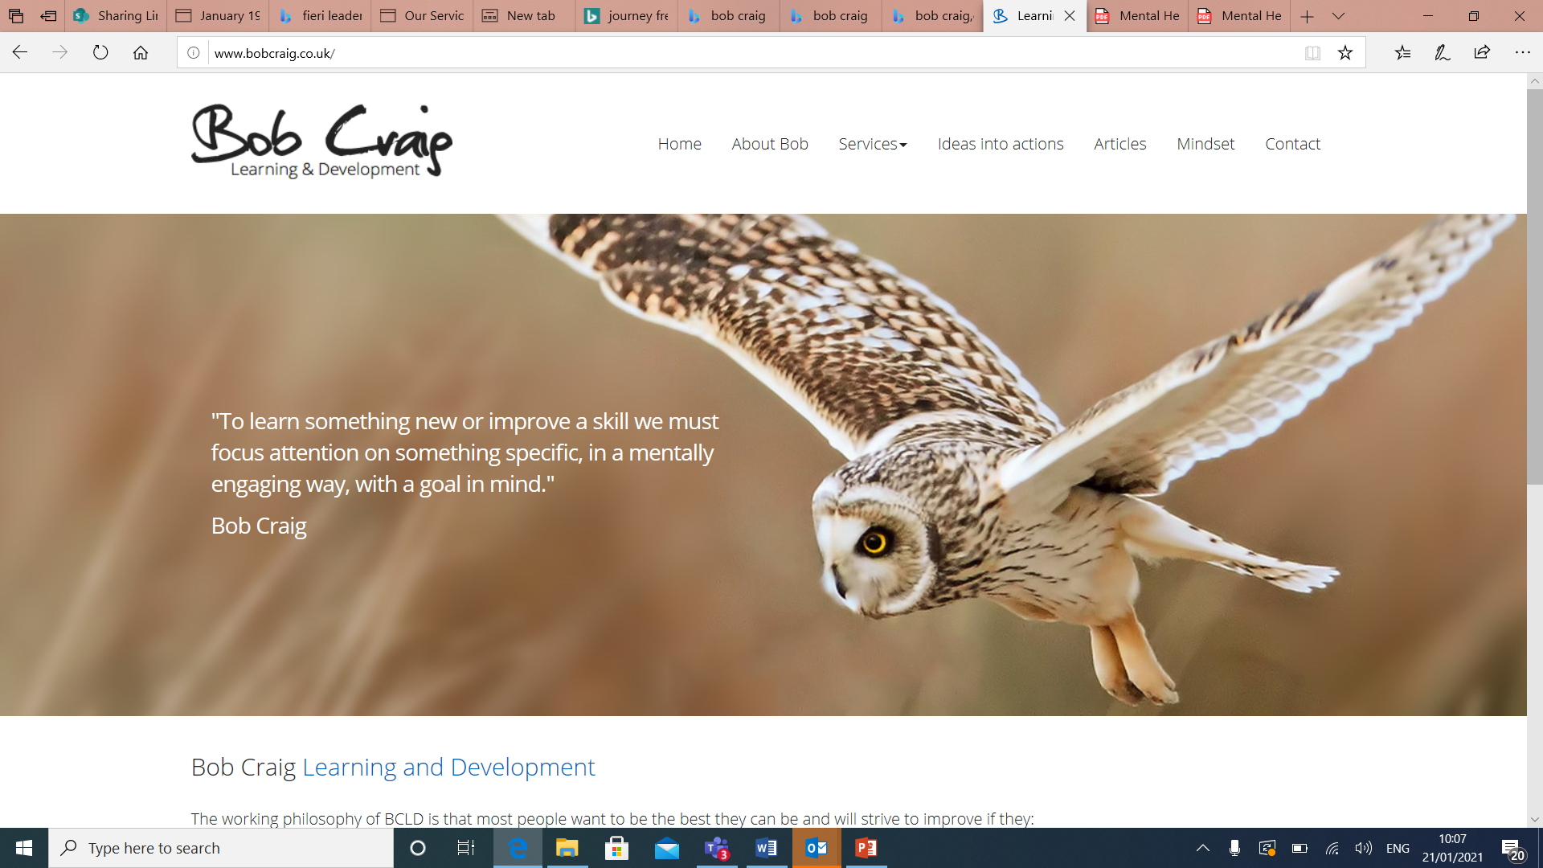
Regular and specialist training
We have done much work with our staff over the past 4 years on specific training to enable them to understand mental health needs, red flags and so on and to be confident to refer when they are concerned
We also did much on the workings of the teenage brain and have an excellent relationship with a consultant, Bob Craig who has helped to train our staff in aspects of delivery, the teenage brain, specialist training for our pastoral team and also training of our student mentors. He has an educational and therapy background but his passion is student mental health

Slide 8
Moving forwards – our plans develop

Slide 9
Greater focus on the journey
Table 1 – Previous action plan focal points, now completed)
Year 1 2017/18 | Focus on auditing College Provision and training staff and continuing to deliver high quality support services. Piloting providing information for parents
Year 2 2018/19 | Focus on providing training for young people, raising awareness for young people and reviewing where staff are in their understanding of key themes by way of questionnaire. Further training for parents available
Year 3 2019/20 | Focus on developing Teacher and Student Toolkits to provide ongoing support and raise awareness of current and emerging issues
Last 4 years more targeted development of our services
Supported from the top by a member of SMT
Clear strategy document for learners and staff support set out and shared with staff. Based on data evidence and shifting needs as identified annually from the data that we collect. Governors are well informed and we have a dedicated governor for MH and Wellbeing as we do safeguarding
Proactive response to the Government Green paper amended 2018 which seeks to have mental health specialist in all schools and colleges by 2023. We like to be on the front foot!
Year 1 2020/21 | Focus on support for students and the current trends related to stress and anxiety, particularly in light of the impact of Covid19 on the education of our young people. Develop a wider set of student support functions including workshop session. Continue to work with external services who auditing College Provision Adequate and updated training staff to enable them to continue to deliver high quality and relevant support services and to take account of learner needs when developing and delivering curriculum Continuing to provide high quality and relevant information for parents Enabling and supporting staff and students to make good personal decisions and choices

Slide 10
Progress being made
Now into our 4th year of action planning and we have a current 3 year plan to take us into 2023
Shared relevant training with others providers
Keen focus on supporting staff by providing relevant training to then support their learners and know what to escalate
Develop our team to provide an excellent service including essential support from 2 members of the SMT and our senior leaders that support them
Clear structure so that staff know where to seek support with learners

Slide 11
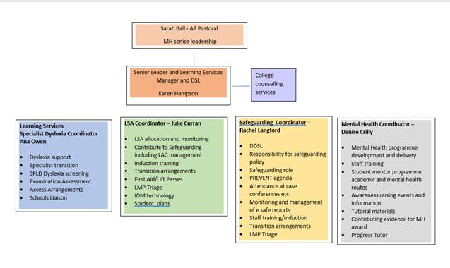
The journey continues
Investment in our team to provide essential services to learners

Slide 12
Spreading our wings and keeping connected
Summer 2020 member of SMT undertakes podcast sponsored by BUPA with MINDS AHEAD
We are also part of NAMSS and contribute at their events
AOC and GM group on mental health
Undertaking an award to recognise the work that our staff do across the college Mental Heath award in FE, run by Minds Ahead
SMT Lead, Sarah Ball, completing Train the Trainer for mental health First Aid so that we can train more staff

Slide 13
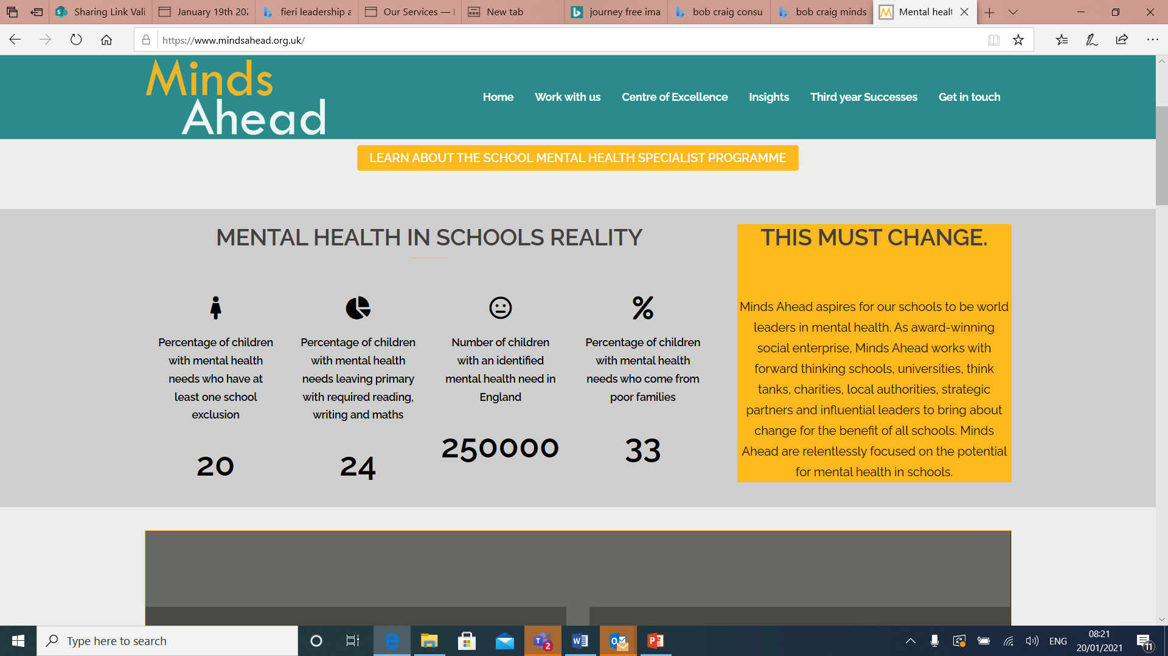
A good place to start

Slide 14
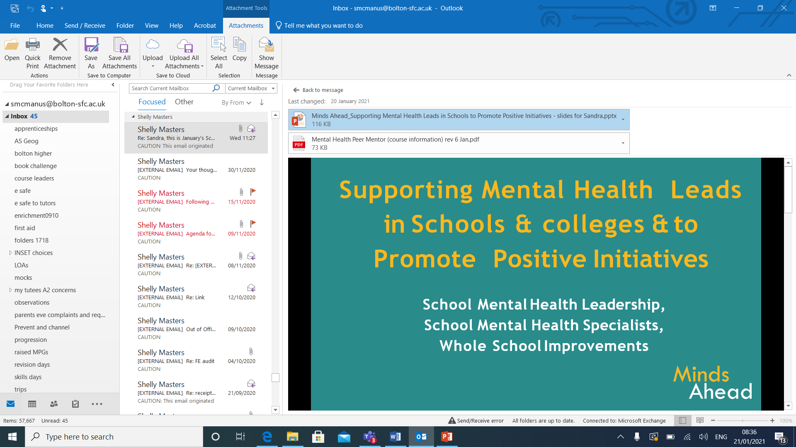
What they offer
Mental health Peer mentor programme
Mental health peer mentoring is integral to whole college / school approaches to supporting student welfare, mental health and wellbeing, yet one that is not always given the priority and recognition it deserves.
A new qualification, delivered by staff, to boost peer-mentoring in your setting.
There are few qualifications for peer mentoring, the Minds Ahead Level 2 Mental Health Peer Mentor programme addresses this. It is accredited by the Royal Society for Public Health, which ensures credibility and recognition for this qualification.
It is suitable for all sixteen to eighteen year old's studying in schools and colleges who are interested in and able to support the mental health and wellbeing of their peers. They will gain a qualification in this widely recognized and transferrable skill. It will be delivered by existing staff enabling more students to access this qualification and to fit it around your existing context.

Slide 15
New this year for learners
Series of workshops delivered by our new Mental Health and Wellbeing coordinator and MH First Aiders
Very well received by the learners involved
Workshops:
Managing Uncertainty and Adapting to Change Part 1 and 2.
Find your calm.
Developing your Wellbeing Toolkit (includes looking at tech available via Apps, IOMs etc)

Slide 16
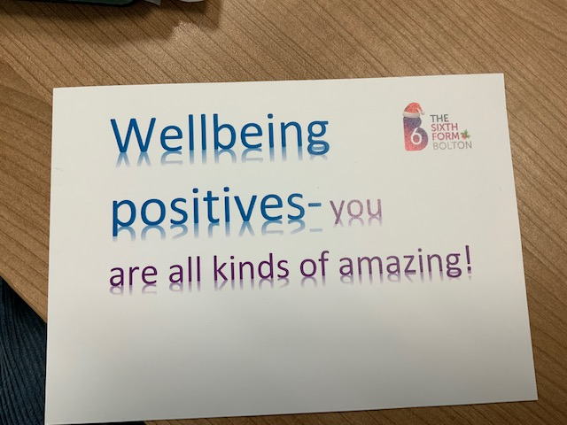
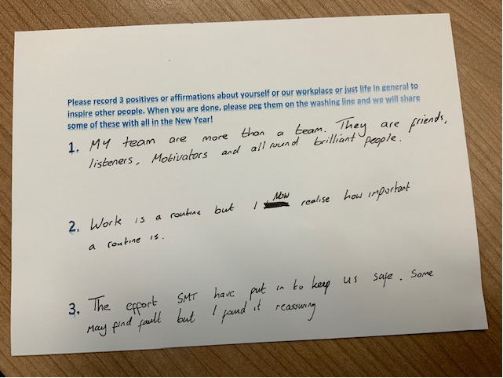
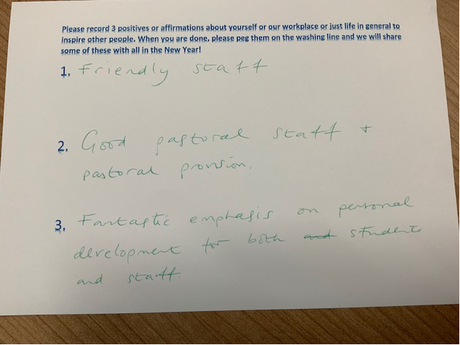
New this year for staff
First staff wellbeing day
Final day of the autumn term
Wellbeing boxes
Wellbeing workshops –
  ‘Flipping your lid’
  Technology to soothe
  Transactional analysis – leaders
  Managing conversations
EAP launched – we use PAM

Slide 17
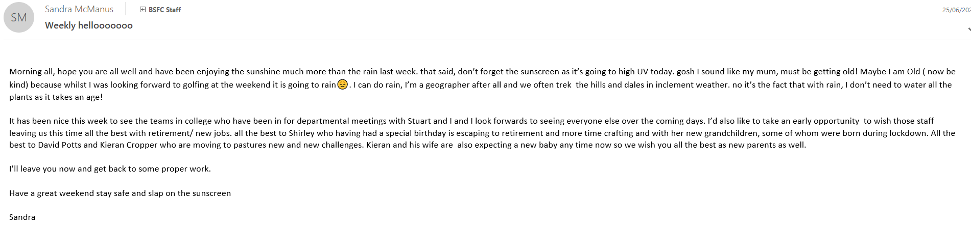
Can’t escape the topic of the hour!
What impact has lockdown had on all of this? Provision remains strong as we have risen to the challenge
Retention remains exceptionally good, higher than this point last year ( fig)
In lockdown one staff delivered welfare packages and tech to those in need
We also visited staff and dropped off treats to say thankyou for their work
We had a weekly electronic keeping in touch email with uplifting information and a hint of silliness, usually at my expense

Slide 18
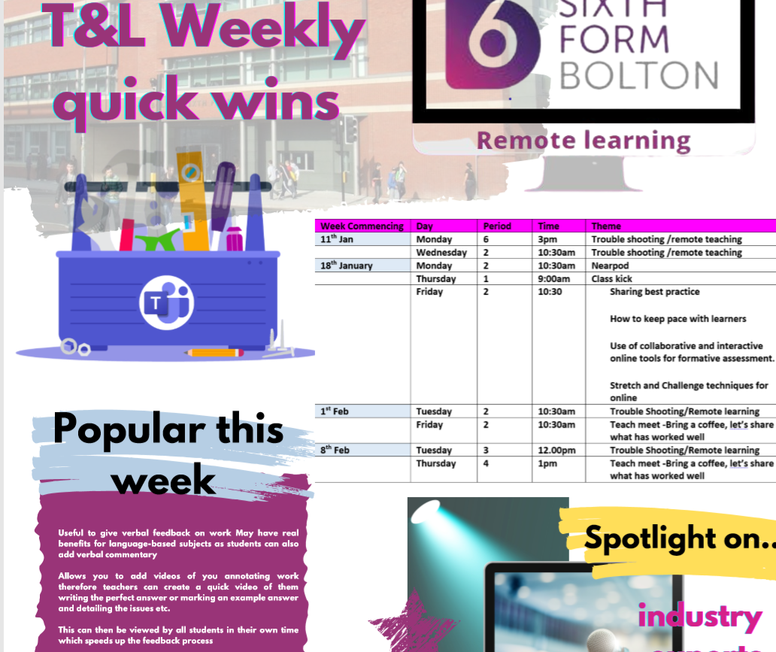
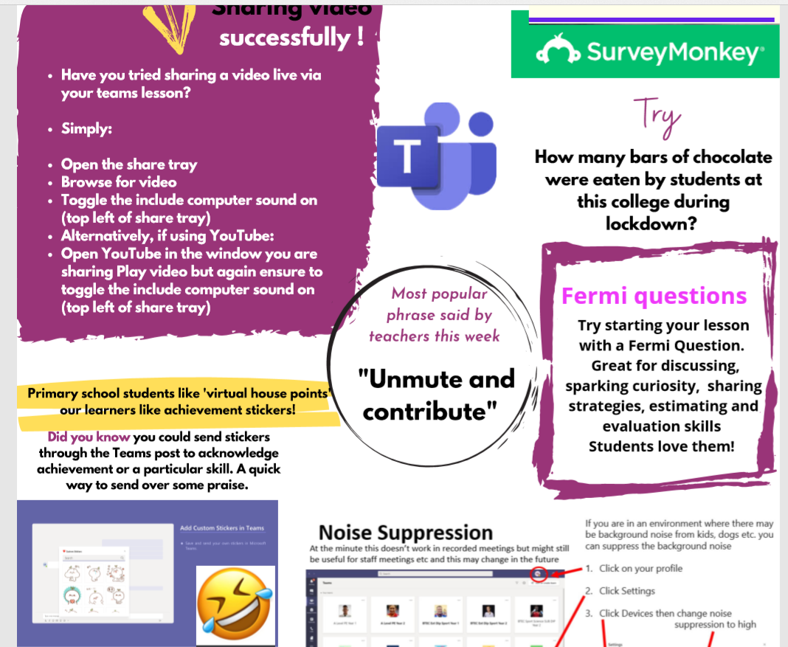
continued
Where learners need more, we do outreach
We publish useful advice and guidance for parents
We pay the Bursary and FSM direct to learners 800+ on bursary alone
Counselling and mentor services remain (face to face available but most choose remote)
Publications have gone to staff to help them understand young people and their needs e.g. Manchester Uni Video
Continue to support staff with the Technology as is a usual source of stress
Progress tutors call all their cohort and there is a weekly bulletin
Online enrichment and wellbeing materials are available to all
Lockdown exercise groups are running

Slide 19
Questions?
Thank you for inviting me to speak today

