Slide 1
Year 9
Half Term 3
Food Art Project

Slide 2
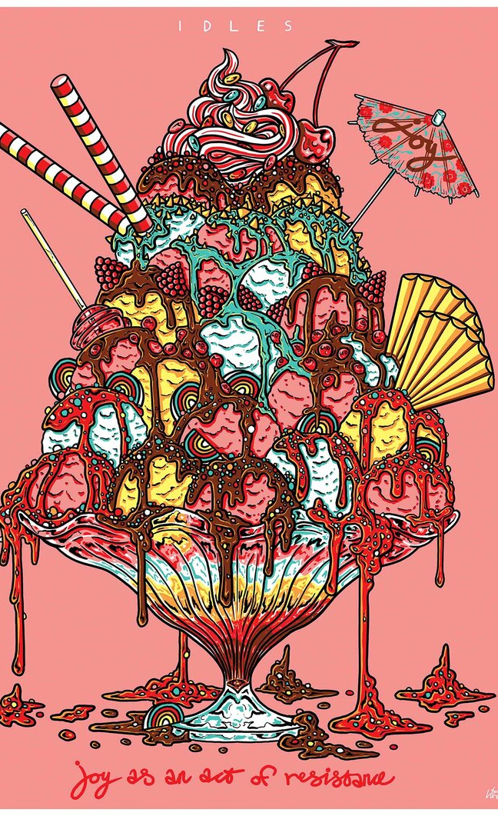
Do now task
Artist Analysis:
DESCRIBE this art in 3 words.
What techniques have been used in the artwork?
What makes this artist successful? Justify your answer. (think about his art style, application of colour, drawing technique)
Answers from everyone in the chat box >>>
Tom Hovey’s illustrations!

Slide 3
Lesson Objectives:
To develop your skills in drawing in the style of Tom Hovey
Focus on LINE detail, accuracy in shape and application of details within each object your illustrate
Create an illustrated recipe card!

Slide 4
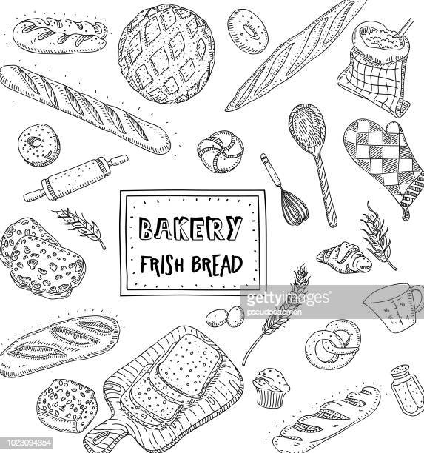
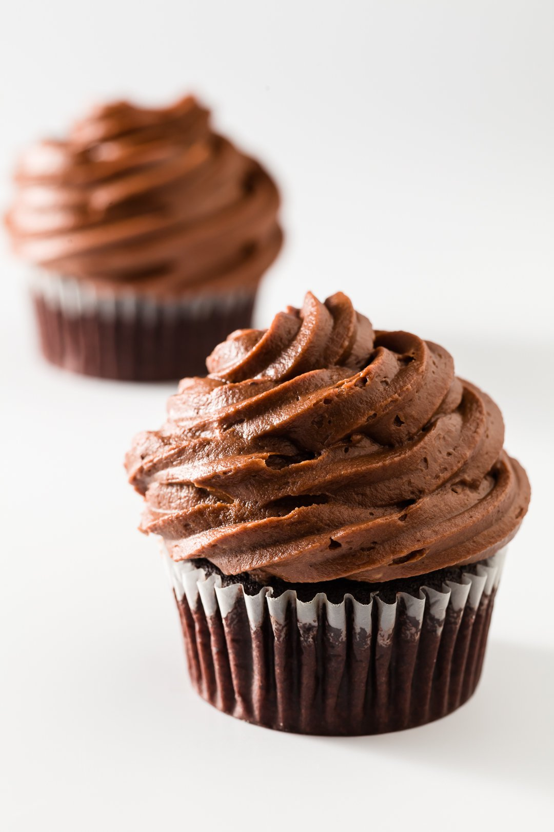
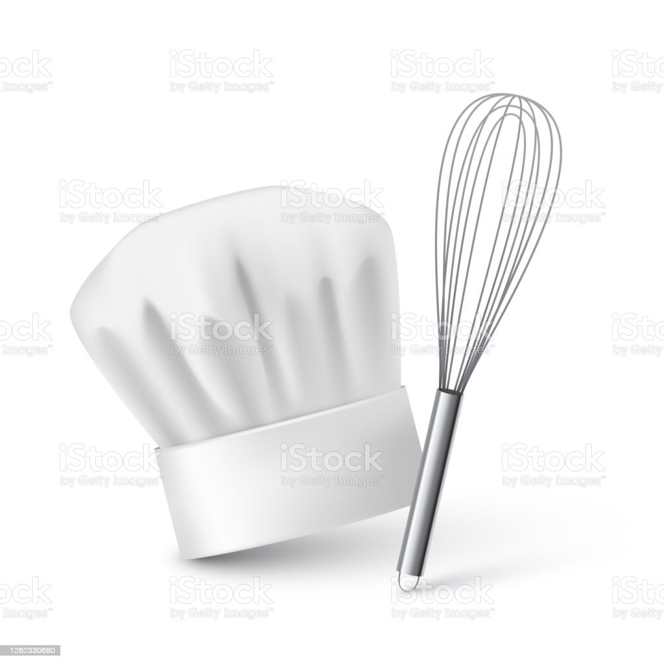
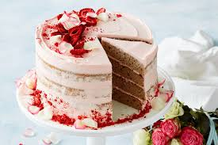
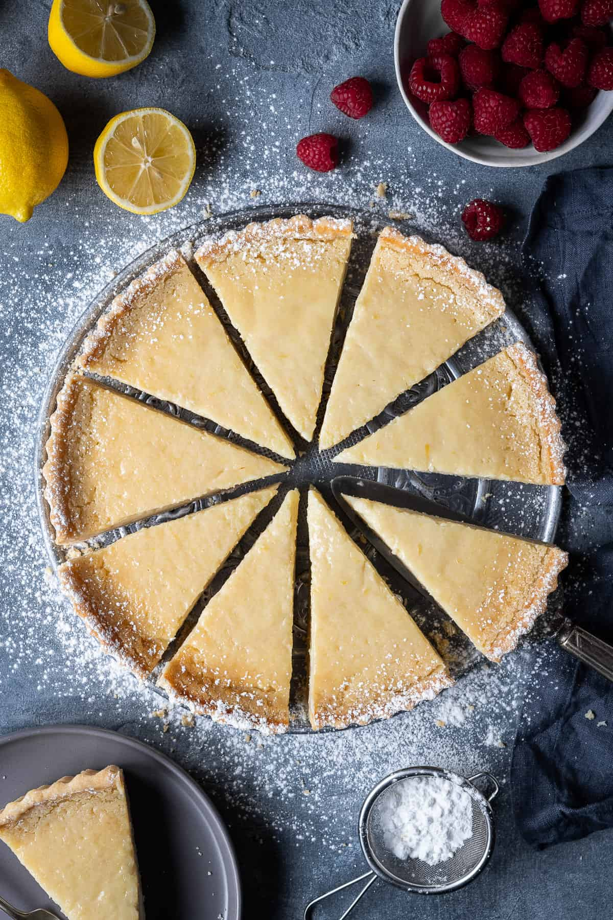
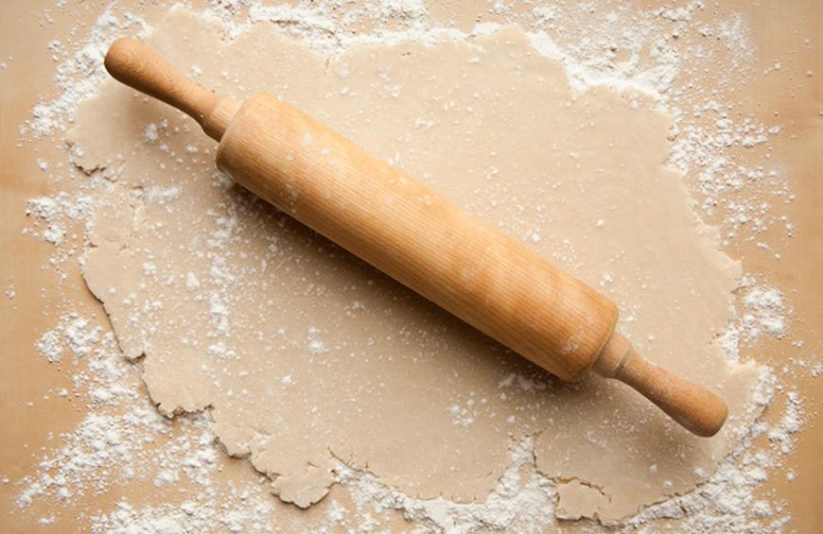
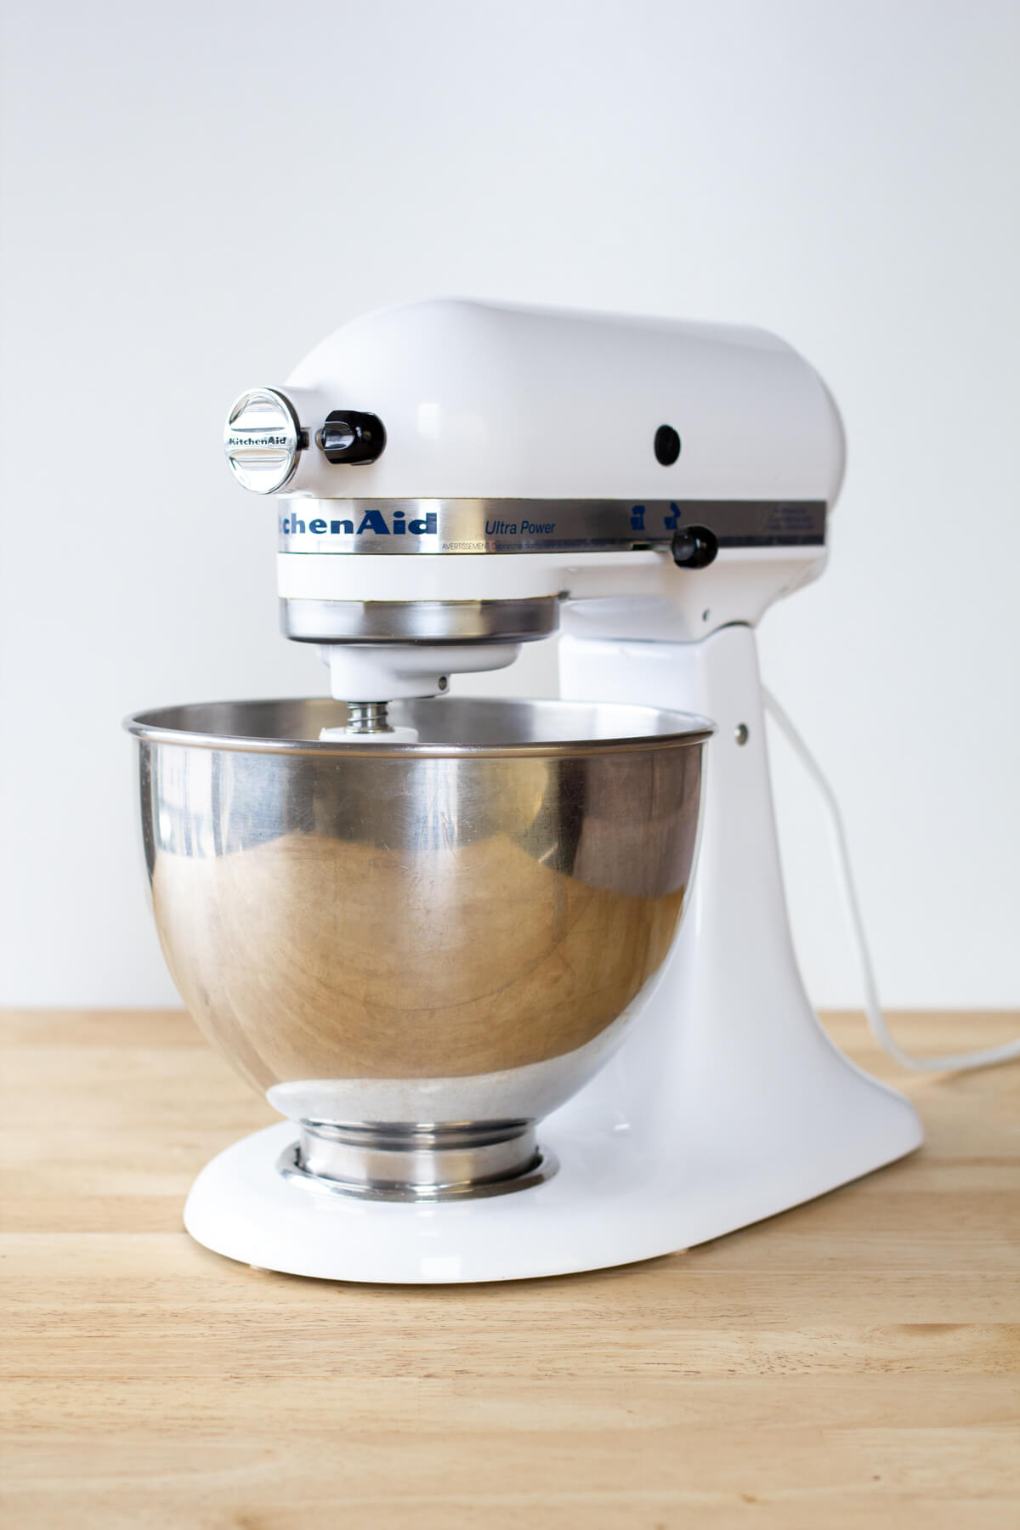

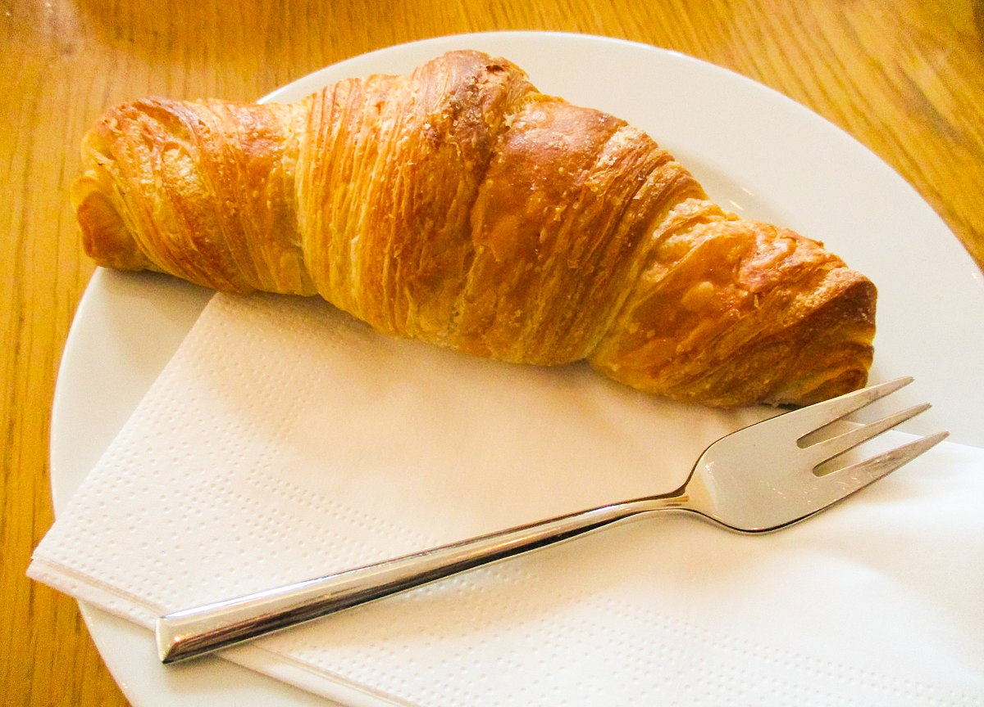
Warm up illustration task!
Turn these images into mini illustrations!
Complete as many as you can in 7minutes!
I’m looking for clear line drawings with details added in! ☺ use this example to help you.

Slide 5
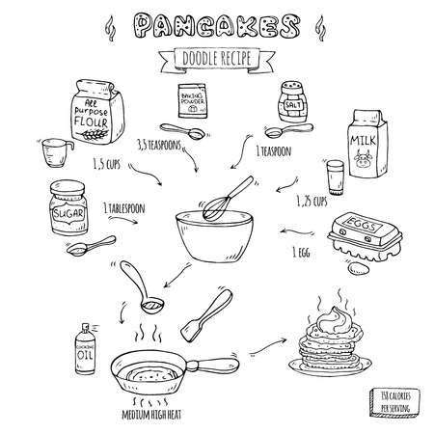
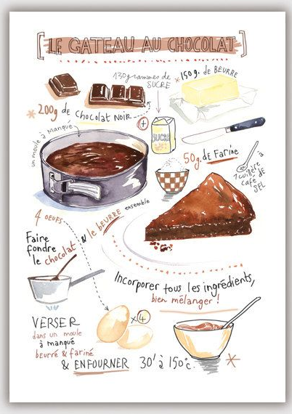
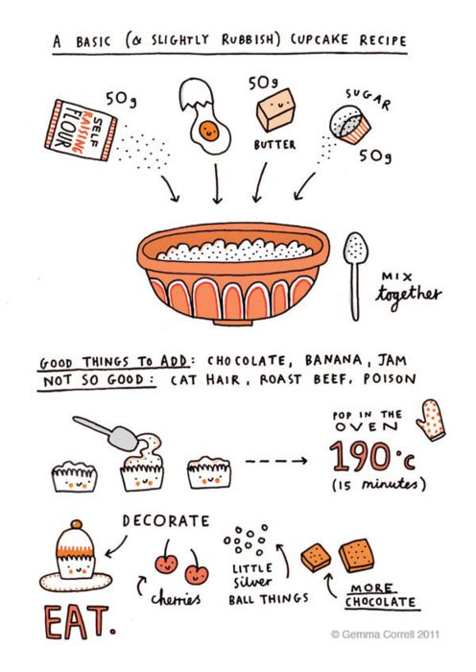
DESIGNING AN ILLUSTRATED RECIPE CARD
Final Thoughts:
What’s been a success with the illustrated recipe cards?
What been difficult when illustrating? Why?
Find a simple dessert recipe (or use the template sheet provided)
Illustrate the KEY POINS for that recipe! (use colours if you have them)
Make notes around your drawings
FANCY title at the top
Be prepared to share your work at the end and hand in ☺

Slide 6
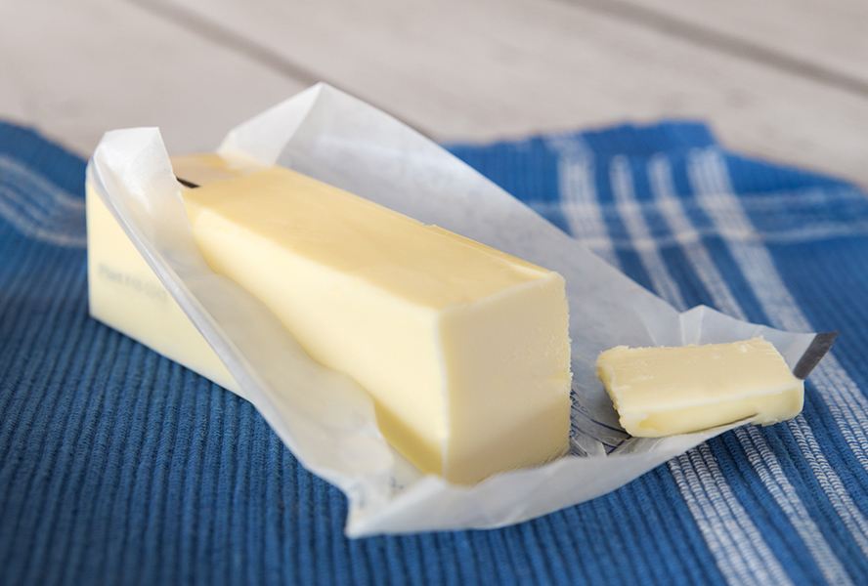
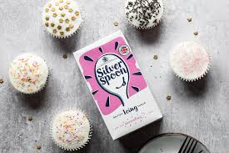
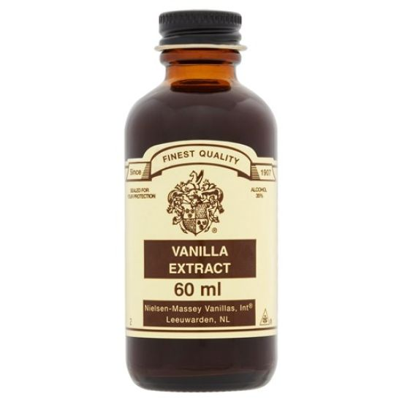
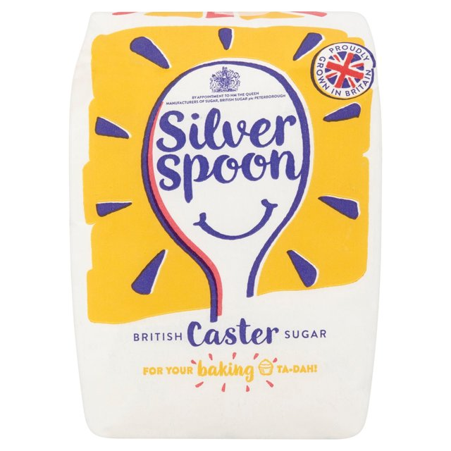
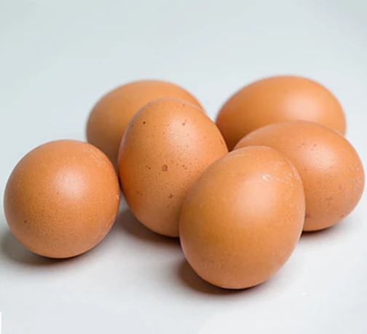
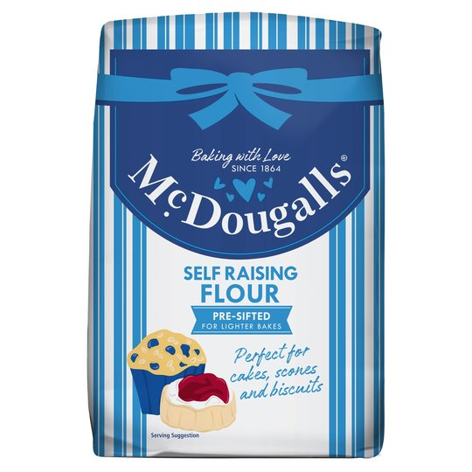
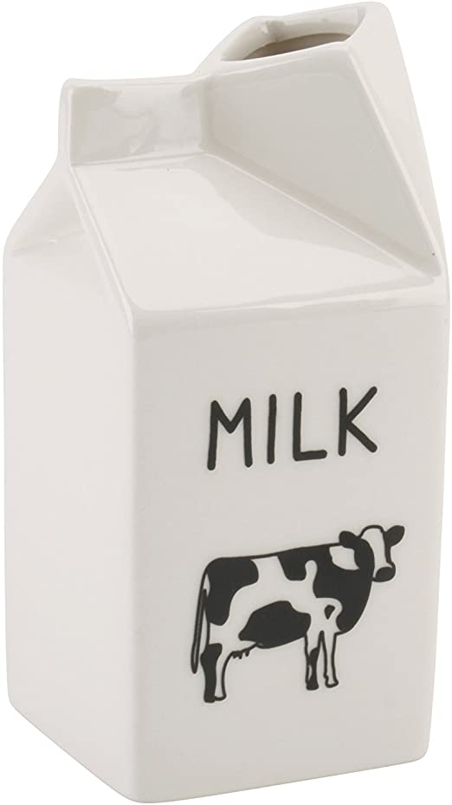
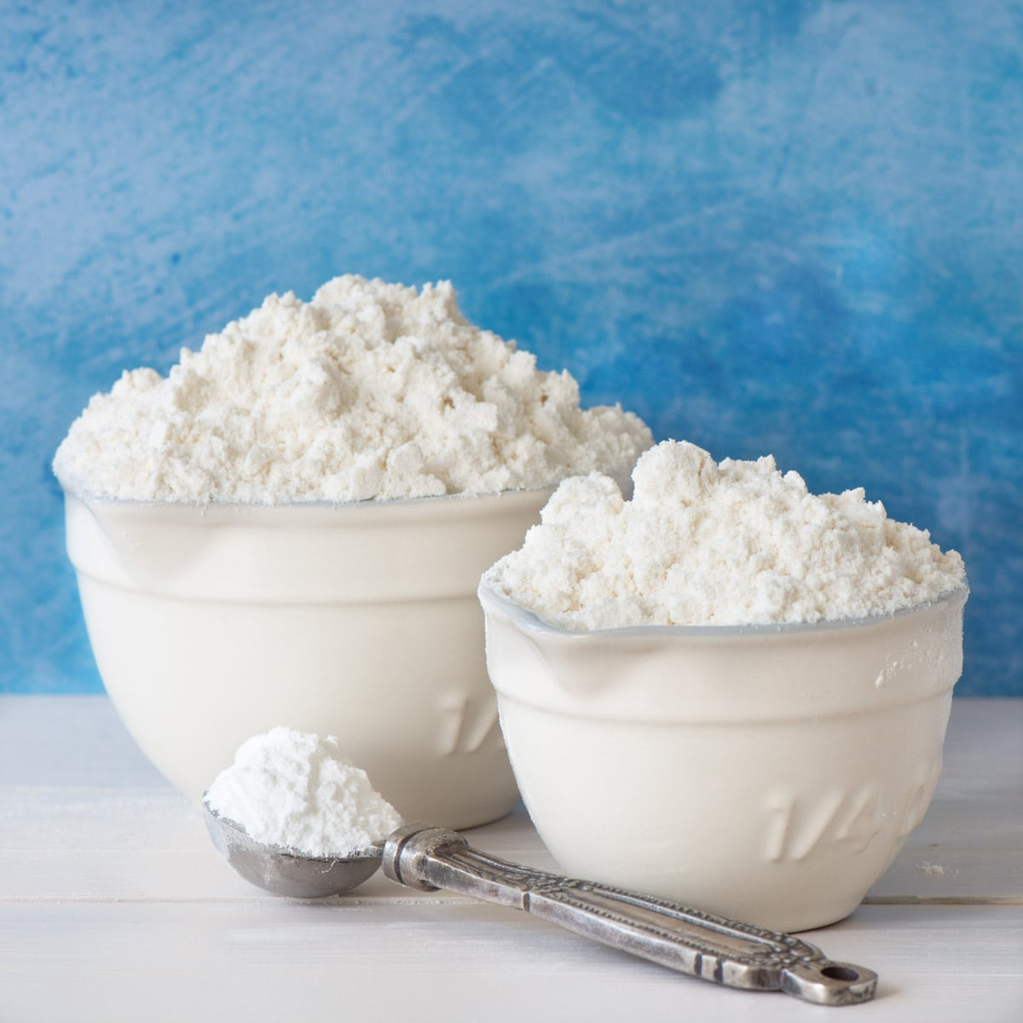
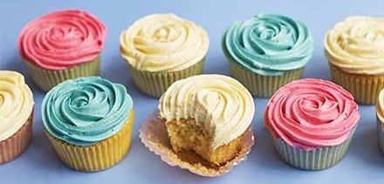
Template Sheet
Cupcake Recipe:
110g softened butter
110g golden caster sugar
2 large eggs
½ tsp vanilla extract
110g self-raising flour
For the buttercream
150g softened butter
300g icing sugar
1 tsp vanilla extract
3 tbsp milk
food colouring paste of your choice (optional)
Instructions (if you want add some of these to your recipe card):
STEP 1Heat oven to 180C/160C fan/gas 4 and fill a 12 cupcake tray with cases.
STEP 2Using an electric whisk beat 110g softened butter and 110g golden caster sugar together until pale and fluffy then whisk in 2 large eggs, one at a time, scraping down the sides of the bowl after each addition.
STEP 3Add ½ tsp vanilla extract, 110g self-raising flour and a pinch of salt, whisk until just combined then spoon the mixture into the cupcake cases.
STEP 4Bake for 15 mins until golden brown and a skewer inserted into the middle of each cake comes out clean. Leave to cool completely on a wire rack.
STEP 5To make the buttercream, whisk 150g softened butter until super soft then add 300g icing sugar, 1 tsp vanilla extract and a pinch of salt.
STEP 6Whisk together until smooth (start off slowly to avoid an icing sugar cloud) then beat in 3 tbsp milk.
STEP 7If wanting to colour, stir in the food colouring now. Spoon or pipe onto the cooled cupcakes.

Slide 7

Handing in time…
Your illustrated recipe card!
To gain your green mark for the lesson:
Submit a clear photo of your work into the assignment by no later than end of the school day. (this is for anyone struggling with time/camera)
Or :
You will have shown your artwork via Camera to miss at the end of lesson.
Sent a clear photo in the chat box.

