Slide 1
Year 7
HT3 Illustration Project
Roald Dahl & Quentin Blake

Slide 2

Materials you will need this lesson:
Paper
Pencil
Pen
(You might need a rubber and Sharpener)
Crayons (Optional – if you decide to add colour to your character illustration)
…But Miss I don’t have Paper…
“It’s okay. We can resolve this simply by using absolutely ANY drawing surface.
This can be the back of an empty cereal box, packaging box, empty envelope, scrap paper (lined or plain), use the back of another exercise book! Get creative!”

Slide 3
Aims for the lesson
To RELATE a piece of text to an illustration
We are going to be looking at the Illustrations of Quentin Blake and explore his drawing style.
To EXTEND our knowledge of the process
illustrators take to create an image.
We are going to use an extract of a Roald Dahl story to create our own interpretation of a character.
To INTERPRET the text through illustration and good use of our imagination
We are going to create an illustration from an extract of a Roald Dahl story imaginatively – no copying here.
Key Word
Illustration

Slide 4
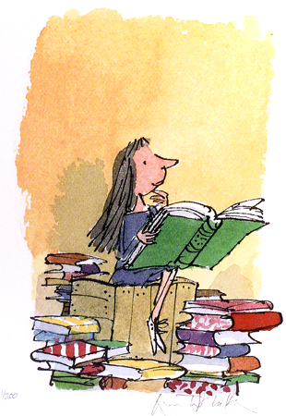
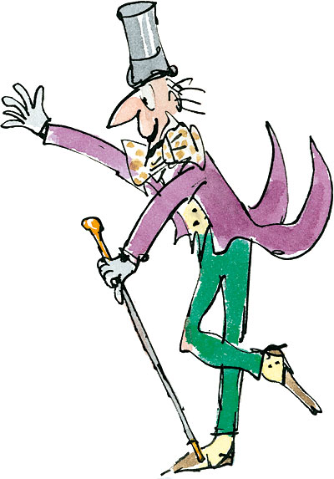
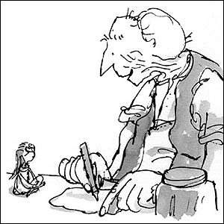

Illustrations
Quentin Blake used the stories written by Roald Dahl to imagine and then draw the characters. He was the ILLUSTRATOR for the books!
Key Word
Illustration

Slide 5
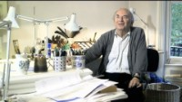
Quentin Blake – Let’s meet him
https://www.youtube.com/watch?v=06rYXkIhBtY
Click the link to play the video

Slide 6
Keywords from the text
Task 1: Read the text that is on the next slide, then pick out the key words and features that describe Mr Twit.
Extension Question: What kinds of images do they make you think of?
At the top of you page write todays date and title:
‘ILLUSTRATING A PIECE OF TEXT: THE TWITS’
Then make a mind map for your key words (an example has been done for you)
Hairy Faced
Mr Twit
Notes:
This slide gets printed for the students

Slide 7
Mr Twit was one of these very hairy-faced men. The whole of his face except for his forehead, his eyes, and his nose, was covered with thick hair. The stuff even sprouted in revolting tufts out of his nostrils and ear-holes.
Mr Twit felt that this hairiness made him look terrifically wise and grand. But in truth he was neither of these things. Mr Twit was a twit. He was born a twit, and now at the age of sixty he was a bigger twit than ever.
The hair on Mr Twit’s face didn’t grow smooth and matted as it does on most hairy-faced men. It grew in spikes that stuck out straight like the bristles of a nailbrush.
And how often did Mr Twit wash this nailbrushy face of his?
The answer is NEVER, not even on Sundays. if you peered deep into the moustachy bristles sticking out over his upper lip, you would probably see much larger objects that had escaped the wipe of his hand, things that had been there for months and months, like a piece of maggoty green cheese or a mouldy old cornflake or even the slimy tail of a tinned sardine.
Extract

Slide 8
Mr Twit was one of these very hairy-faced men. The whole of his face except for his forehead, his eyes, and his nose, was covered with thick hair. The stuff even sprouted in revolting tufts out of his nostrils and ear-holes.
Mr Twit felt that this hairiness made him look terrifically wise and grand. But in truth he was neither of these things. Mr Twit was a twit. He was born a twit, and now at the age of sixty he was a bigger twit than ever.
The hair on Mr Twit’s face didn’t grow smooth and matted as it does on most hairy-faced men. It grew in spikes that stuck out straight like the bristles of a nailbrush.
And how often did Mr Twit wash this nail-brushy face of his?
The answer is NEVER, not even on Sundays.
if you peered deep into the moustachy bristles sticking out over his upper lip, you would probably see much larger objects that had escaped the wipe of his hand, things that had been there for months and months, like a piece of maggoty green cheese or a mouldy old cornflake or even the slimy tail of a tinned sardine.

Slide 9
ANY MORE TO ADD …
Hairy Faced
Aged 60
Nail Brushy
face
Mr Twit
Thick Hair
Tufts of hair
spikes
Notes:
This slide gets printed for the students

Slide 10

Mr Twit – Your interpretation
Key Word
Illustration
Task 1(a): Your task now is to create an illustration (drawing using the text to help you) of Mr Twit (this means your own version!).
Extension: Label the key features you have drawn.
Use your imagination and creativity.
At this point using the extract you just read you will only be able to draw his FACE (neck upwards). Read through the extract carefully yo get your drawing illustrated brilliantly! I look forward to seeing your creations.
You only have 5 minutes!

Slide 11
For the next task you are going to create a copy of Mr Twit based on the STYLE and TECHNIQUES of Quentin Blake.
Ensure you copy his loose lines.
Sketchy Lines.
And if you have colours you can complete the task in colour too! (if you don’t have colours then your drawing is to be handed in as a pencil or pen drawing)

Slide 12
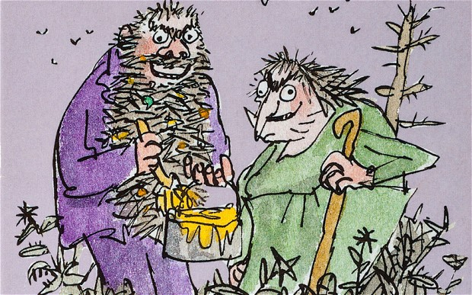
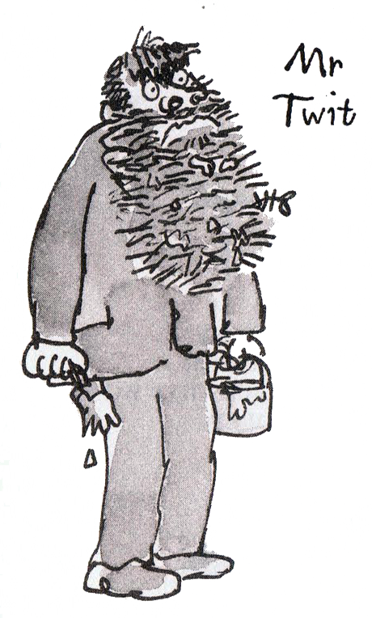

Drawing Mr Twit (Task 2)
Choose one of these images to copy
OR follow this link: copy the artist https://www.youtube.com/watch?v=KsqZ1aMPldQ&t=117s
Loose outlines
Clear body shape
Rough looking beard
‘wonky’ lines
Large circular shaped nostrils
Key Word
Sketching
You only have 10 minutes!
Task 2(b) Self Assess your drawing.
I think I have done well with copying the…
This is because I have used the _______ technique of Quentin Blake
I think I need to improve …
I can achieve this by making sure that I …

Slide 13
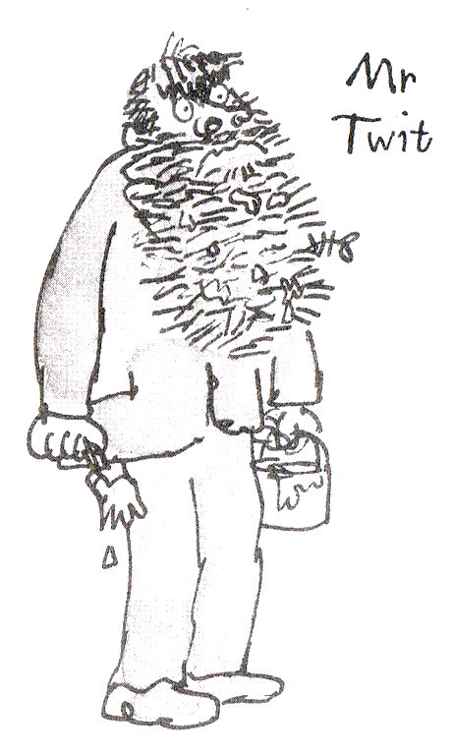
Choose one of these images to copy

Slide 14

Handing in time…
Your own Mr Twit Drawing
Mr Twit Copy
Take a clear photo of all and hand in to your assignment to get your mark for this lesson ☺

Slide 16
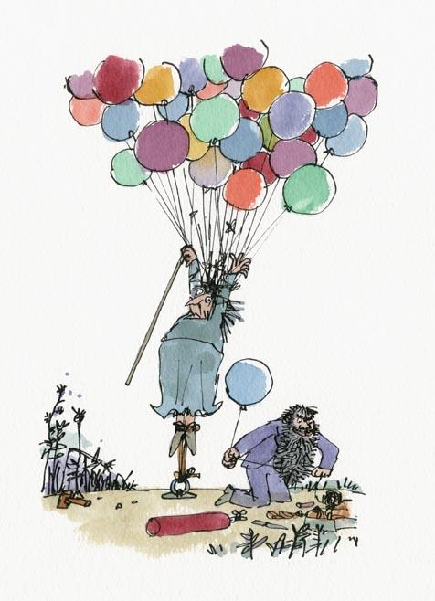
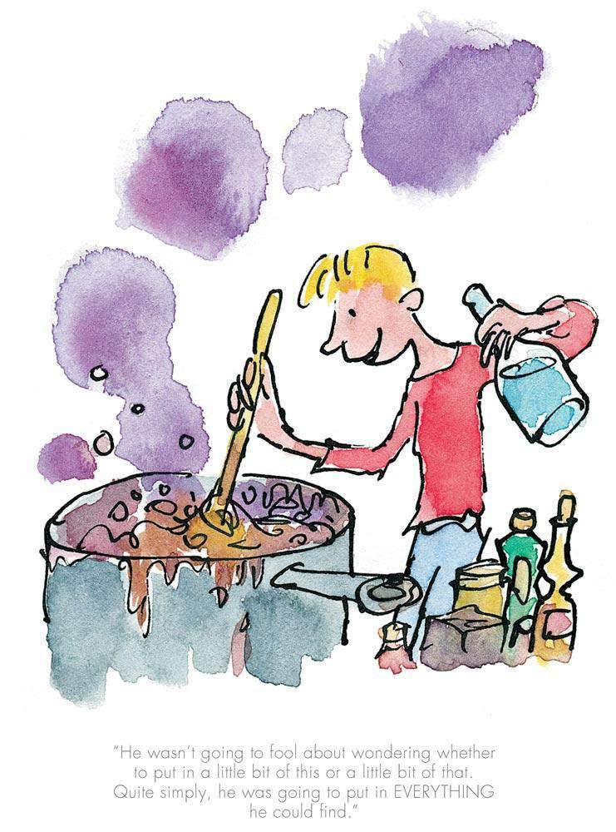
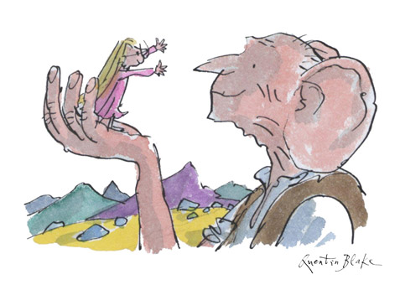
DO NOW TASK
DESCRIBE the illustrations of Quentin Blake using ART KEYWORDS.
Write your answer in the chat box…

Slide 17
Aims for the lesson
SELECT the most appropriate key words from the extract in order to sketch your own imaginative version of the characters in action
APPLY a clear and imaginative sketch in response to the extract
IDENTIFY the key features detailed in the extract in order to come up with your own version of The Twits illustration
Key Word
Illustration

Slide 18
Task 1: Can you note down any key words and phrases from this extract that would help you in producing an illustration… (Use a mind map or bullet point list)
The Twits (Part 2)
The Wormy Spaghetti
‘Hey, my spaghetti’s moving!’ cried Mr Twit, poking around with his fork.
‘It’s a new kind,’ Mrs Twit said, taking a mouthful from her own plate which of course had no worms. ‘It’s called Squiggly Spaghetti. It’s delicious. Eat it up while it’s nice and hot.’
Mr Twit started eating, twisting the long tomato-covered strings around his fork and shovelling them into his mouth. Soon there was tomato sauce all over his hairy chin.
The Wormy Spaghetti

Slide 19
‘Hey, my spaghetti’s moving!’ cried Mr Twit, poking around with his fork.
‘It’s a new kind,’ Mrs Twit said, taking a mouthful from her own plate which of course had no worms. ‘It’s called Squiggly Spaghetti. It’s delicious. Eat it up while it’s nice and hot.’
Mr Twit started eating, twisting the long tomato-covered strings around his fork and shovelling them into his mouth. Soon there was tomato sauce all over his hairy chin.
Let’s have a think…
What could you DRAW/ILLUSTRATE to go alongside this piece of text?
(Think about the setting, where are they sitting, what is in the background, what else is next to them, what does the text tell you about the food in the plates and about Mrs Twit and Mr Twits actions?)
Task 1(a):
Your task is to come up with your own illustration for this part of the story.
Key Word
Sketching
You only have 10 minutes!

Slide 20
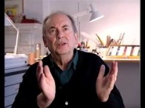
https://www.youtube.com/watch?v=RyX1l0VqlOw
Click the link to watch the video
Coming Up…
Let’s have another insight into Quentin Blake and his story on The Twits and how they were illustrated/invented!
Watch carefully, as you will be asked some questions relating to the video by Miss!

Slide 21
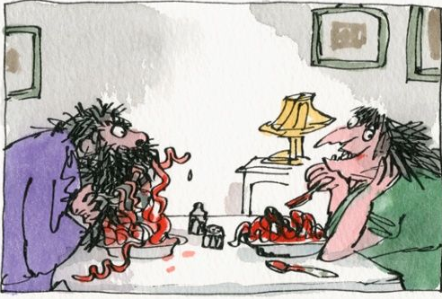
The Wormy Spaghetti Quentin Blake’s illustration
Let’s discuss the following 3 questions
What effect does the colour RED give in the illustration?
What EMOTION is Mrs Twit feeling? What makes you say this?
Why do you think Quentin Blake has made Mr Twit looking ‘confused’?
How does your illustration compare to Blake’s? Any similarities or differences?

Slide 22
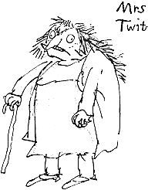
Drawing Mrs Twit
You only have 3 minutes!
DRAWING WARM UP SKETCH!
https://www.youtube.com/watch?v=c394tPCQbdw
10 minutes
Task 2(a)
You can choose to draw Mrs Twit from the image on the right.
OR
Follow this tutorial video:
https://www.youtube.com/watch?v=h1ZoHCBxJk8
You only have 10 minutes!
End

Slide 23
Handing in time…
Your own illustration of ‘The Wormy Spaghetti’
Mrs Twit Copy
Take a clear photo of all and hand in to your assignment to get your mark for this lesson ☺

