Slide 1


5 Resources and Ideas

Slide 2
Resource 1:
Ultimate Scheme of Work
Me ☺
https://diagnosticquestions.com/Quizzes/EediUltimateSOW

Slide 3
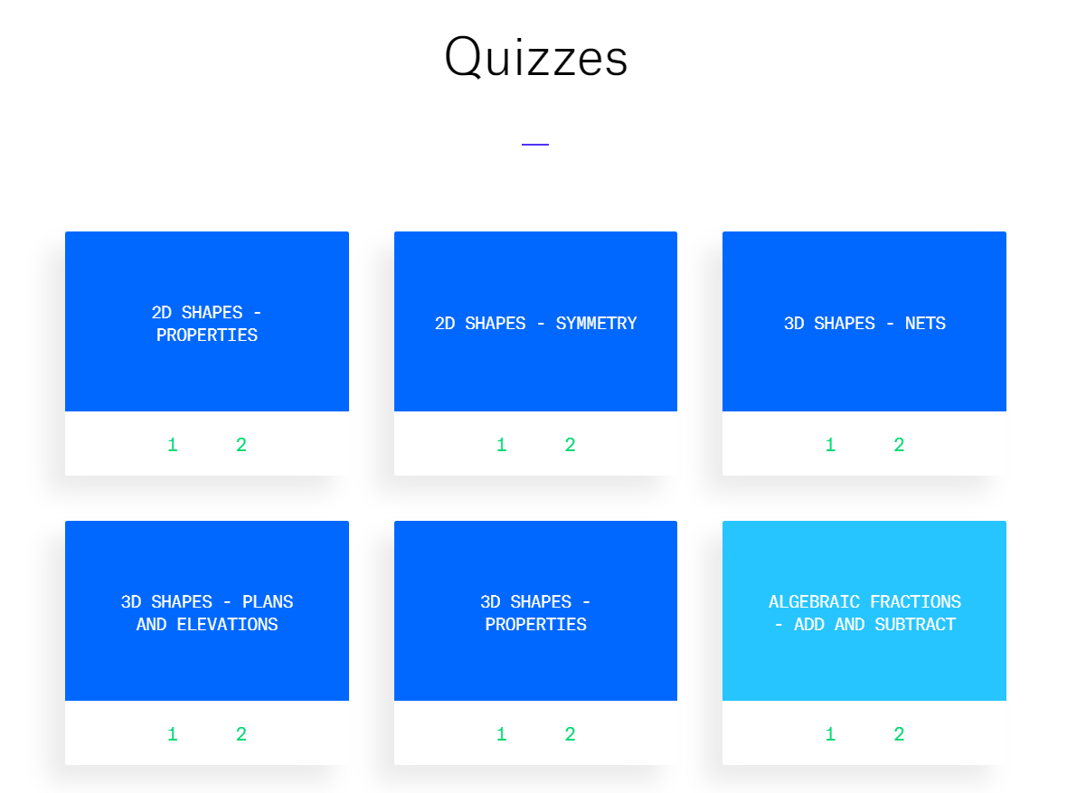

Slide 4

craigbarton.podia.com/

Slide 5
Resource 2:
WRM spreadsheet
Mrs Hawthorne
https://sketchcpd.com/resources

Slide 6
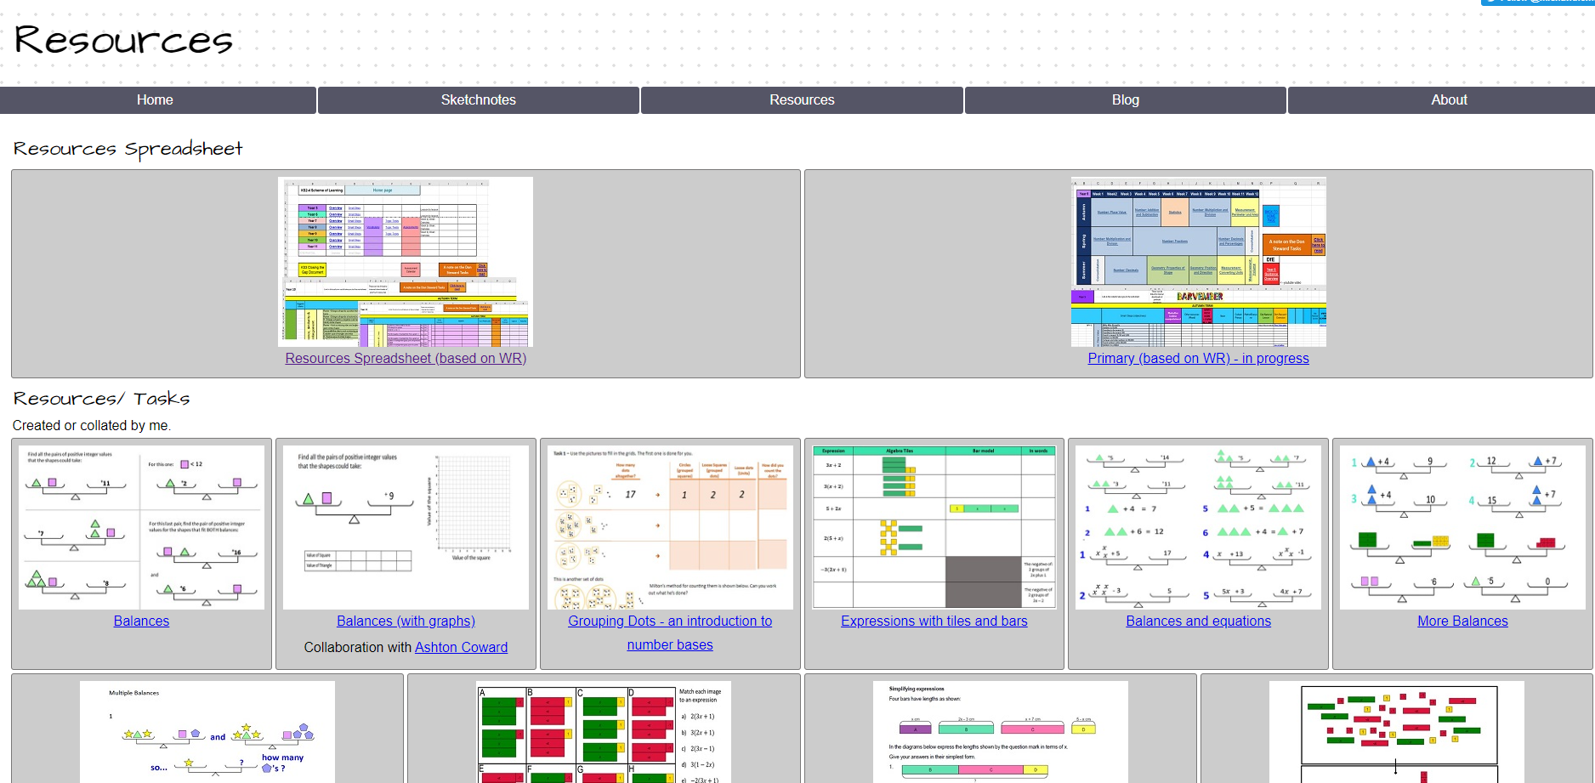

Slide 7
Resource 3:
Prime Factor tiles
Jonathan Hall
https://mathsbot.com/manipulatives/primeTiles

Slide 8
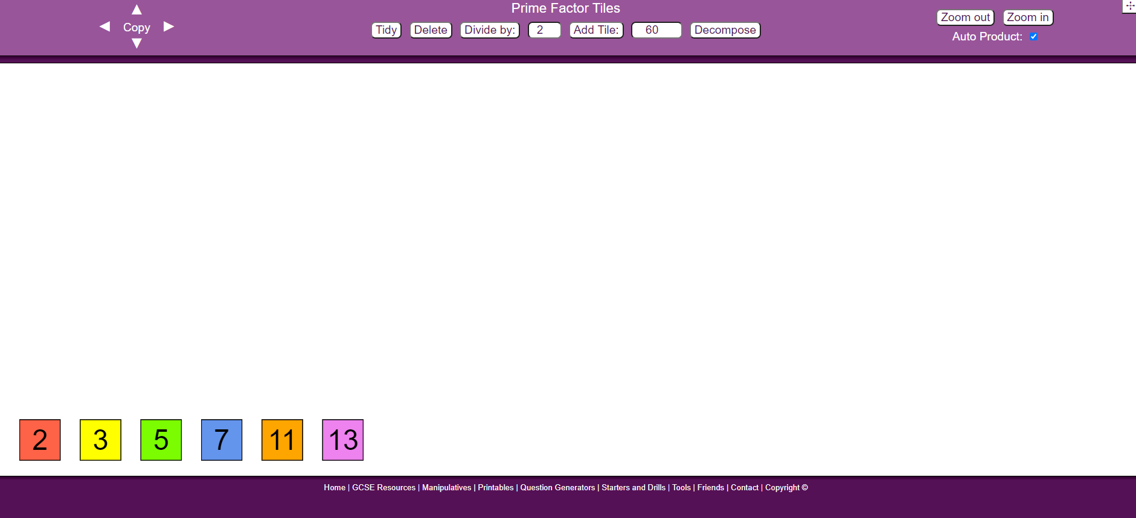

Slide 9
Resource 4:
R-infinity starter
Miss Jaggers
https://www.jaggersmaths.co.uk/r-infinity

Slide 10
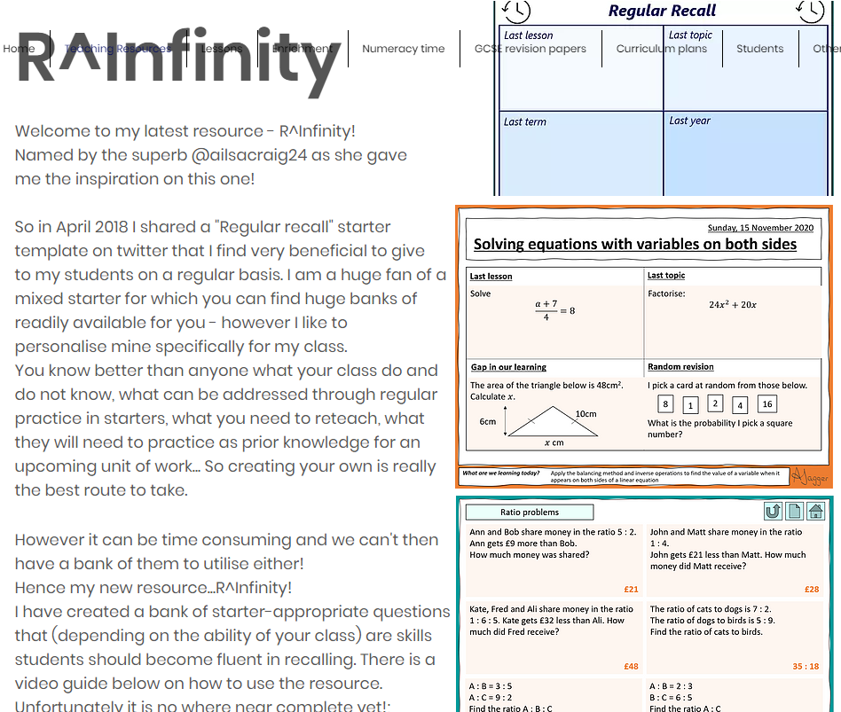

Slide 11
Resource 5:
Starting Points
Chris McGrane
https://startingpointsmaths.com/

Slide 12
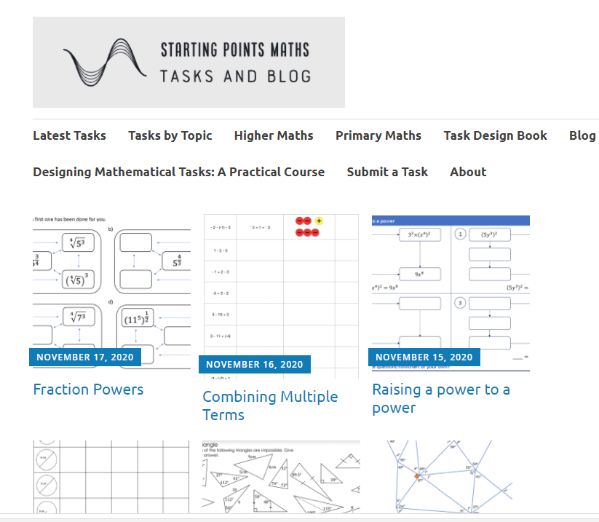

Slide 13
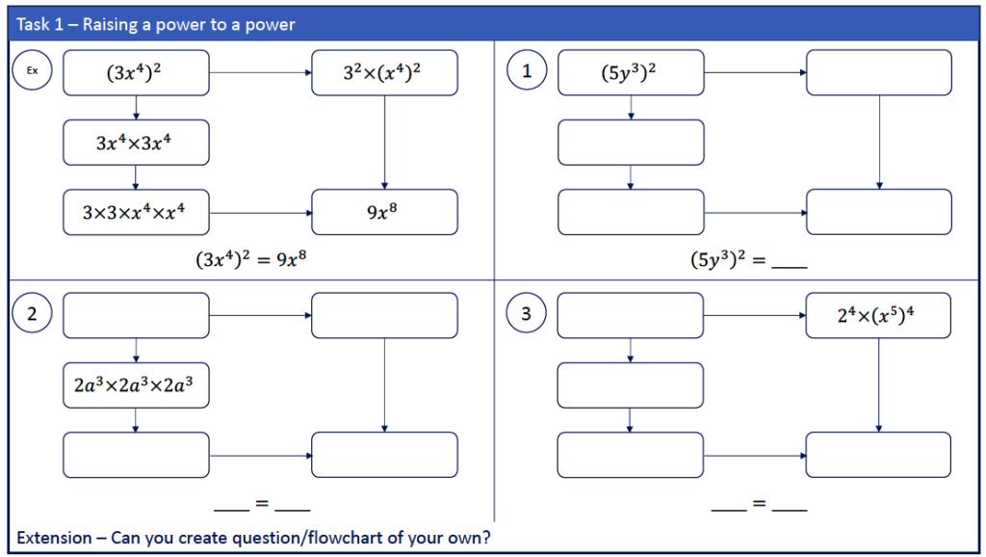

Slide 14
