Slide 1
Admissions, Outreach & Recruitment update
Karen Burns – Student Recruitment Manager
Nichola Mason – Student Recruitment Officer (North West)
Claire Roberts – Undergraduate Admissions Officer
Martin Walker – Outreach Officer
Mutty Dad – Recruitment and Conversion Manager (LUMS)
Notes:
Hi and welcome to this session. My names is Elle Zientek and I am a graduate of Lancaster, and I now work in our Global Recruitment Office, which means I am part of a team that supports students with their next steps into university. In this session I’m going to give you an introduction to Lancaster, both the city and the university.

Slide 2
Admissions Update
Claire Roberts – Undergraduate Admissions Manager
Notes:
Hi and welcome to this session. My names is Elle Zientek and I am a graduate of Lancaster, and I now work in our Global Recruitment Office, which means I am part of a team that supports students with their next steps into university. In this session I’m going to give you an introduction to Lancaster, both the city and the university.

Slide 3
Admissions update
Admissions cycle 2021 (national picture)
  Changes to dates and deadlines
  Exams, results and clearing
National HE admissions reform
Admissions at Lancaster

Slide 4
What’s new in schools engagement?
Karen Burns – Student Recruitment Manager
Nichola Mason – Student Recruitment Officer (North West)
Notes:
Hi and welcome to this session. My names is Elle Zientek and I am a graduate of Lancaster, and I now work in our Global Recruitment Office, which means I am part of a team that supports students with their next steps into university. In this session I’m going to give you an introduction to Lancaster, both the city and the university.

Slide 5

Our reputation

Slide 6
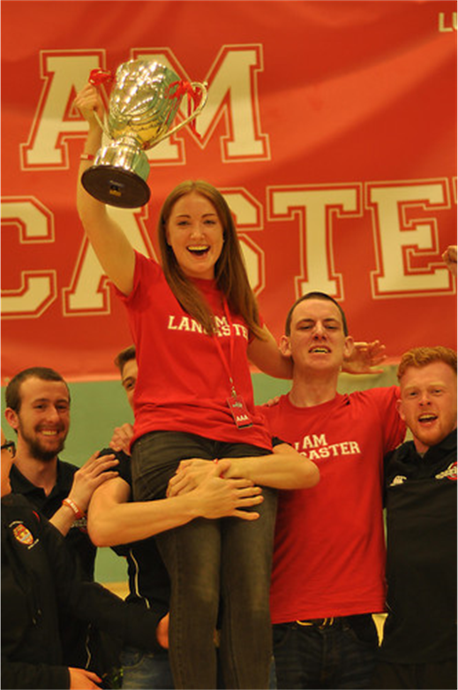
Digital engagement
Open access webinars: to support HE progression and ​subject specific www.lancaster.ac.uk/connect
Digital resource hub: resources for students and teachers
https://www.lancaster.ac.uk/working-with-schools/schools-resource-hub/
Content on demand: pre-recorded sessions that you can share at your convenience
Bespoke sessions: live sessions with interactive Q&A
Virtual HE fairs : UCAS and UK University Search

Slide 7
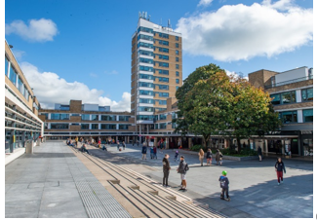
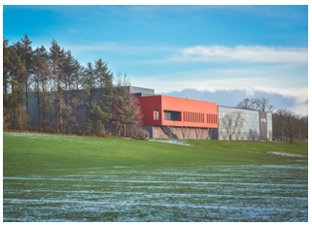
New initiatives for 2020/21
Information and support for parents and carers: tailored webinars, parents guide and newsletter, dedicated point of contact: parents@lancaster.ac.uk
Activities for pre-16s: to support key decision points e.g. GCSE and level 3 choices
Teacher CPD: twilight sessions from January 2021
Subject engagement: Masterclasses, tasters, lectures

Slide 8
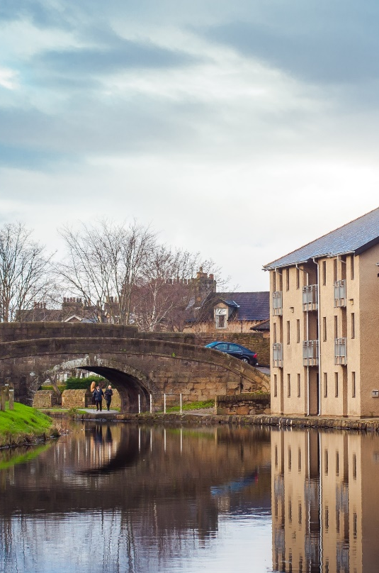
Discussion points
How has Covid-19 affected students’ decision making?
How are students getting their information in the absence
of UCAS fairs and Open days?
How can we support them and you?
How can our academics engage?
How can we engage with parents?

Slide 9
Outreach and Widening Participation
Martin Walker, Outreach Officer (FASS & LUMS)
Notes:
Hi and welcome to this session. My names is Elle Zientek and I am a graduate of Lancaster, and I now work in our Global Recruitment Office, which means I am part of a team that supports students with their next steps into university. In this session I’m going to give you an introduction to Lancaster, both the city and the university.

Slide 10

The Student Lifecycle at Lancaster
The Outreach and Success Team: Support and engage students across the lifecycle. Before and after they arrive at Lancaster.
Outreach
Transition
Student Success

Slide 11
Who do we work with?
AM I ELIGIBLE?
I am from a low income background (i.e. household income of £30,000 or less)
I am from a neighbourhood where higher education participation is low (POLAR4 Quintile 1, can be checked using the tool below)
I am the first in my family to progress to higher education (Neither of your parents attended university except as a mature student)
I am from a certain minority ethnic group
I have a disability
I have a mental health problem, Specific Learning Difficulty and/or am on the autism spectrum
I am in receipt of free school meals
I am eligible for pupil premium
I am in care, looked after or a care leaver
I have caring responsibilities
I am estranged from my family
I am from a gypsy or Traveller community
I am a refugee or asylum seeker
I am from a military family
Predominantly work with students from under-represented backgrounds
School/College Criteria:
Outreach Schools Target List
  LPN, FSM, Progress 8, Attainment 8, local schools.
Individual Criteria :
Most activities require meeting young people/students to meet 2 WP criteria.
  Can be flexible on this.

Slide 12
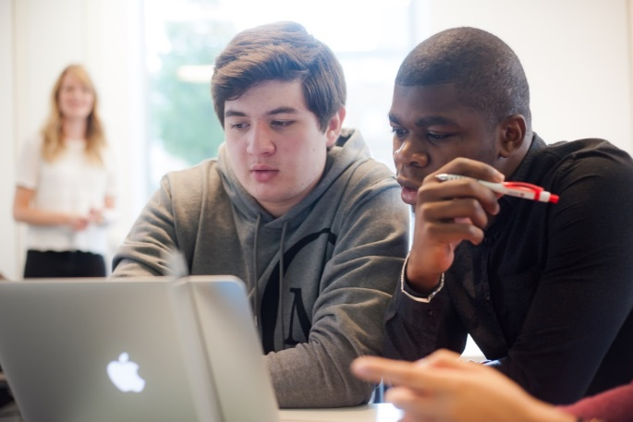
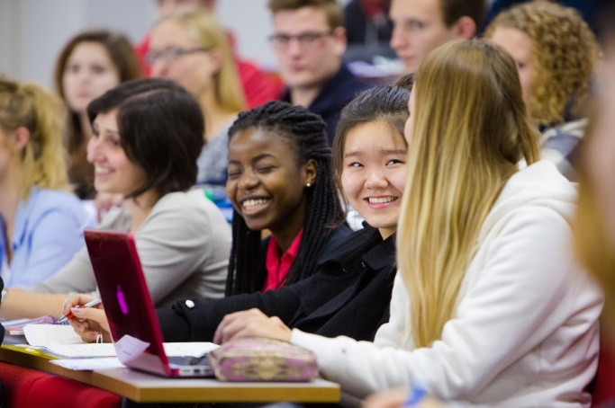
Outreach Activity: Year 12/13 & BTEC
* Usually on-campus, online for the immediate future.
FASS Taster Days
Multi-subject taster sessions for A level/BTEC students designed to give them a taster of university in different Arts and Social Sciences subjects.
LUMS Taster Days
Multi-subject taster sessions for A level/BTEC students designed to give them a taster of university in different Management-related subjects.
STEM Taster Days
Multi-subject taster sessions for A level/BTEC students designed to give them a taster of university in different STEM subject areas.
Summer Schools (Arts/Social Sciences, Science/Technology, Medicine)
Insight into what it’s like to study at undergraduate level: lectures, seminars and essay assignments etc.

Slide 13

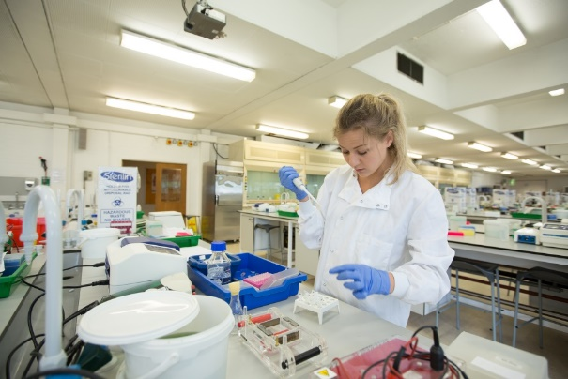
Outreach Activity: Year 9 & 10
* Usually on-campus, online for the immediate future.
Discover FASS
Taster sessions for Year 9 and 10 students in subjects not currently available to them in High School to inspire them to think beyond the curriculum.
Discover LUMS
Taster sessions for Year 9 and 10 students in subjects not currently available to them in High School to inspire them to think beyond the curriculum.
STEM Challenge Day
An event for Year 9 students in which they compete in a STEM subject area on behalf of their school.

Slide 14
Lancaster University Management School
Mutty Dad – Recruitment and Conversion Manager
Notes:
Hi and welcome to this session. My names is Elle Zientek and I am a graduate of Lancaster, and I now work in our Global Recruitment Office, which means I am part of a team that supports students with their next steps into university. In this session I’m going to give you an introduction to Lancaster, both the city and the university.

Slide 15

Lancaster University Management School
Our new normal
Our community
Activities
  Masterclasses/Taster Days
  Meet the Management School drop-ins
  “100-day Challenge”
  Open for Business

Slide 16
Contact us
Karen Burns – k.burns1@lancaster.ac.uk
Nichola Mason – n.mason5@lancaster.ac.uk
Claire Roberts – c.l.Roberts@lancaster.ac.uk
Martin Walker – m.walker3@lancaster.ac.uk
Mutty Dad – m.dad@lancaster.ac.uk

