Slide 1

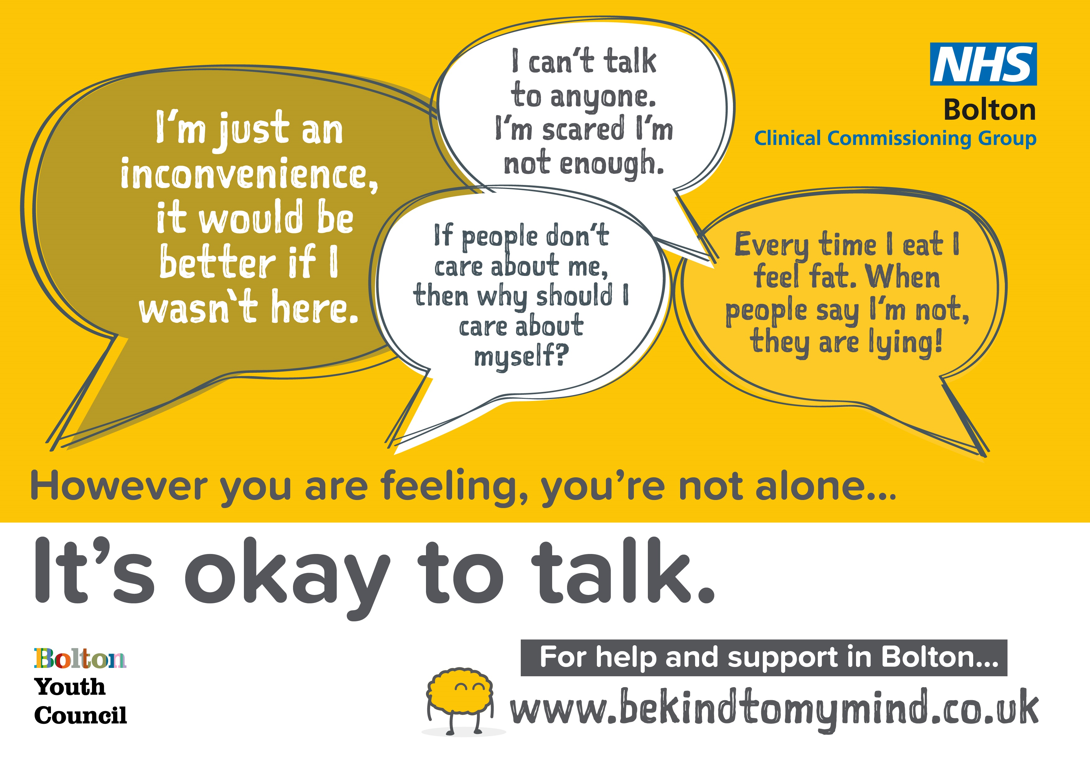
Children and Young People’s Mental Health Update – Safety and Welfare Hub
Jo Higham – Head of Strategic Commissioning for Children and Young People in Bolton & Greater Manchester commissioning lead for CYP Mental Health
Sarah Whitehead – Commissioning Manager for Children and Maternity
Dr Mark Bowers – Consultant Clinical Psychologist / Clinical Lead for Bolton CAMHS

Slide 2

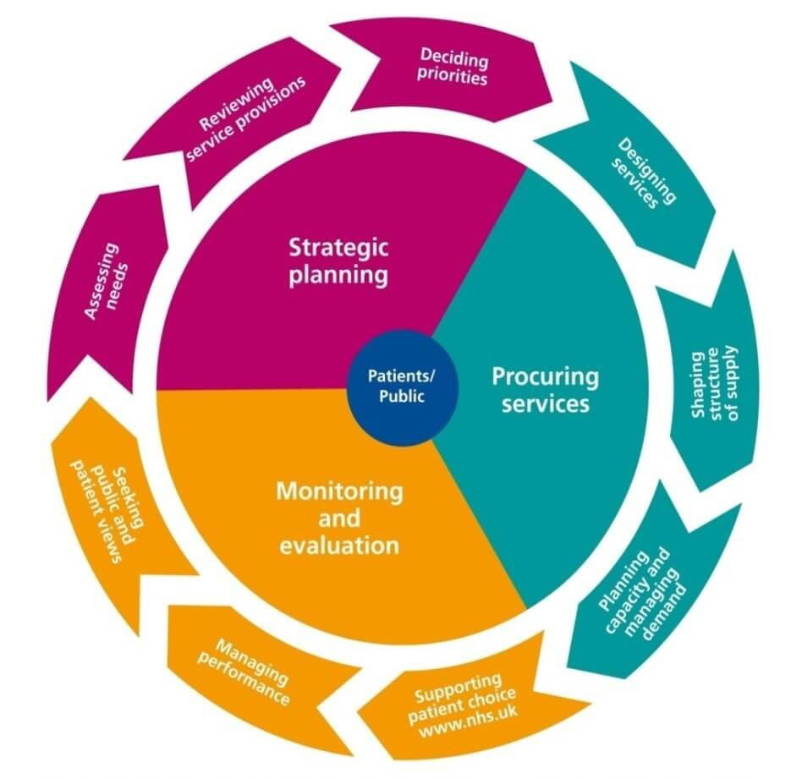
Who are NHS Bolton CCG?
NHS Bolton Clinical Commissioning Group are a member organisation that bring together all 49 GP Practices in Bolton to ensure children, young people and adults have safe and high quality health care services which get the best possible health outcomes for the local population.
Bolton CCG are split up into a range of sub-structures aligned, where possible, to Bolton NHS Foundation Trust. Each team includes strategic leads and an associated clinical lead who is a practicing GP. This includes:
  Urgent and Planned Care
  Community Integration
  Adult Mental Health and Learning Disabilities
  Women and Children’s
  Business Intelligence
  Contracts & Finance
  Funded Care
Bolton CCG’s Women and Children’s Team are responsible for planning and commissioning a range of services/provision including but not limited to:
  CYP Mental Health
  Acute Paediatrics
  Community Paediatrics
  Allied Health Professionals
  Learning Disabilities and/or Autism
  Continuing Care
  Palliative and EOL Care
  Maternity
  Gynaecology

Slide 3

Children and Young People’s Mental Health
The transformation of children and young people’s mental health is led locally by NHS Bolton Clinical Commissioning Group (CCG) with professionals from across the NHS, Public Health, Children’s Social Care, Education, Youth Justice and the Voluntary Sector working together with children, young people and their families to design and provide the best possible services for their locality.
To enable consistency of provision across all 10 localities in Greater Manchester, a significant amount of work is also done across the GM footprint
In order to receive additional investment from NHS England in line with the Five Year Forward View for Mental Health (2016) and more recently the NHS Long Term Plan (2019), Bolton CCG are required to produce an annual refresh of their Local Transformation Plan. Bolton’s Local Transformation Plan for Children and Young People’s (CYP) Mental Health was refreshed and published in March 2020.
To ensure Bolton is on track to meet the ambitions set out in the Local Transformation Plan, a Children and Young Peoples Emotional Health and Wellbeing Transformation Group has been put in place which consists of key leads across Health, Social Care, Education, Youth Justice & Voluntary Sector.
Key priorities for 2020/21 :
  Covid-19 Response
  Access and Waiting Times
  Expand and enhance crisis care offer
  Perinatal and Parent Infant Mental Health
  Embedding Thrive
  Transforming Care Programme – CYP with LD and/or Autism
Click here to read Bolton’s 2020/21 Local Transformation Plan for Children and Young People’s Mental health

Slide 4
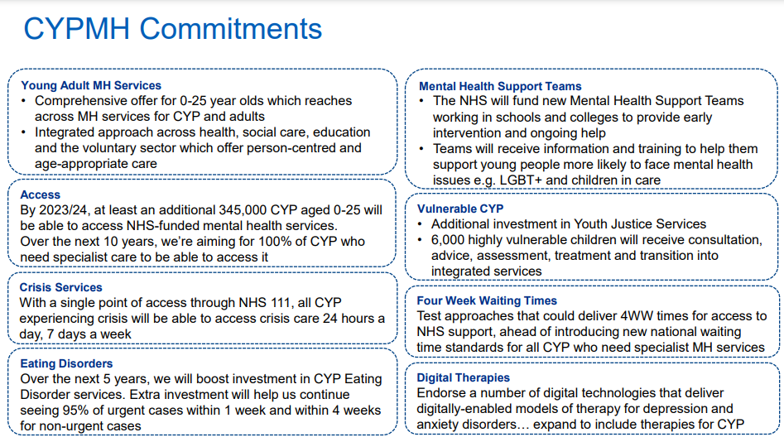

Slide 5
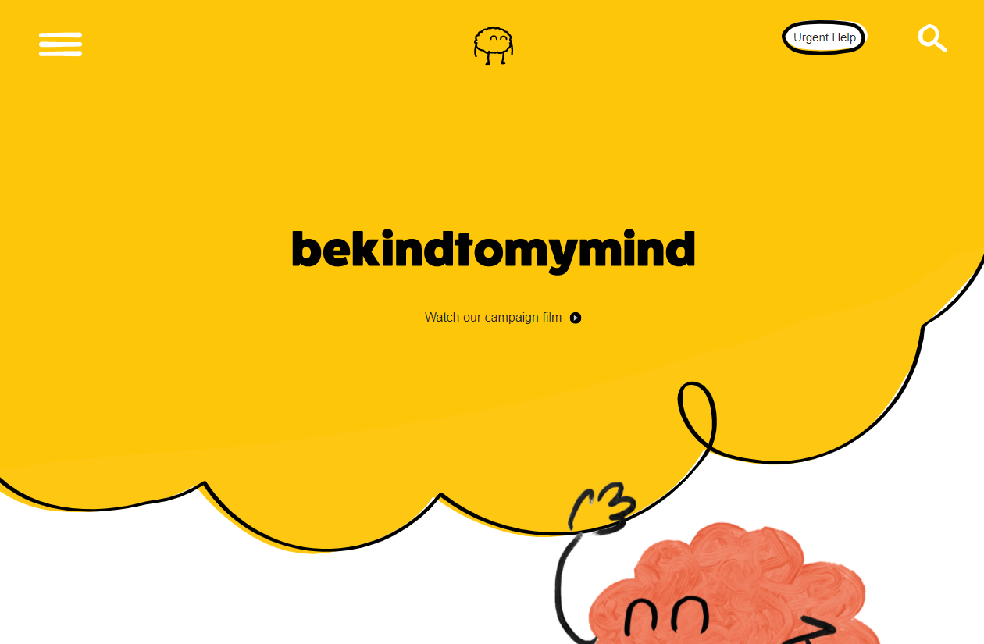
How can you find out what is available in Bolton?
In 2018, Children and Young People from Bolton’s Healthy Mind Youth Project talked to Bolton CCG about the work they have been doing to reduce mental health stigma across Bolton
They had developed a campaign called Be Kind to My Mind and wanted support to deliver it at scale
Young people said that in order to help themselves and others they needed a central place where they could find information about what was available locally.
Bolton CCG worked alongside a design company to develop a digital platform which included a directory of services for young people. This is called www.bekindtomymind.co.uk
In 2019, a 6 Week Campaign was launched targeted at Children and Young People in Bolton using the microsite as a ‘call to action’
We are constantly looking at ways to promote Be Kind to My Mind to Children and Young People in Bolton. If you would like further information about how to promote the campaign please email bolccg.cypcommissioning@nhs.net
By December 2020 there will be a part-expansion to Bolton’s microsite to include a dedicated section for Professionals with a full launch taking place in March 2021
Click here to watch Bolton’s Be Kind to My Mind campaign video

Slide 6
Bolton’s Digital Offer
Click here to access Kooth’s promotional hub for posters, brochures, videos and more
Kooth
Commissioned by NHS Bolton CCG since Feb 2017 for Children and Young People (CYP) in Bolton aged 11 -25
It can be accessed for free via www.kooth.com – simple anonymous registration.
Access to 1:1 text based counselling ,messaging function, moderated forums, self-help materials and articles
Professionals can emailed Heather Hook (Kooth Integration and Participation Worker for Bolton) on hhook@kooth.com to request a free virtual information session to enable staff to find out more about Kooth and how it can support some of the children and young people they may work with.
Chat Health
Commissioned as part of Bolton’s Integrated Children’s Health and Wellbeing Service (0-19)
CYP aged 11 - 19 can text 07507 331753 to speak to a Public Health Nurse for support on topics including bullying, sexual health, alcohol and drugs and mental health and wellbeing.
Parents/Carers can text 07507 331751 with questions ranging from breastfeeding support and child development, to behavioural issues and general advice.
SHOUT
Commissioned by Greater Manchester as a text-based crisis support service for all ages. The service is available 24/7 with trained crisis volunteers who will chat using trained techniques and connect individuals to further support within their area.
Text GMBolton to 85258
Blue Ice (prescribed by CAMHS)
An evidence-based app to help young people manage their emotions and reduce urges to self-harm. This app has launched and is currently only available from a clinician working in CAMHS
SilverCloud (16+)
SilverCloud is for people aged 16 or over who need help with mental health issues and the emotional challenges associated with long-term conditions. It is an online course which uses Cognitive Behavioural Therapy (CBT) to help individuals manage stress, anxiety and depression.
https://GM.silvercloudhealth.com/signup

Slide 7
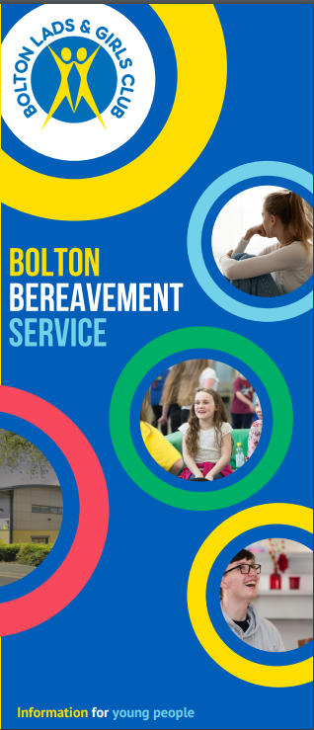
Bereavement Support in Bolton
Click here to access the Bereavement Support Leaflet (BLGC)
Aligned to the Thrive model, a dedicated children and young peoples bereavement service has been mobilised to ensure that young people who are bereaved are able to access the most appropriate support for their needs.
The service, provided by Bolton Lads and Girls Club, is for children and young people aged 8 to 18 who live in Bolton.
The service offers:
Advice and signposting for young people, parents and professionals (provided by BLGC)
1-1 Listening service (provided by BLGC and Zac’s)
1-1 Low Level Therapeutic Sessions with Goal based outcomes (provided by BLGC )
Peer Support (Further down the line provided by BLGC )
1-1-Counselling (provided by Fort Alice).
The following slides have also been developed to summarise a range of local and national resources/services that are available to support young people who are bereaved. The slides also include support to staff.
Children and Young People’s Bereavement Support

Slide 8
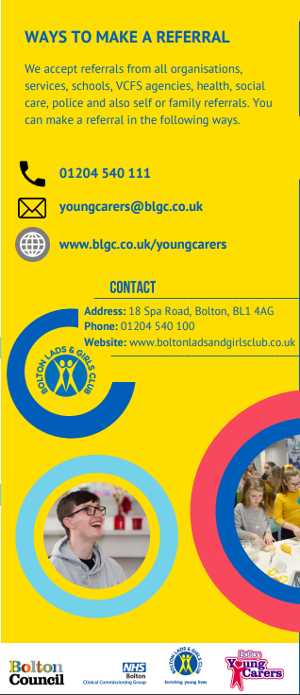
Bolton Young Carers Service
Click here to access the Young Carers Leaflet (BLGC)
A young carer is a person under 18 who regularly provides emotional and/or practical support and assistance for a family member who is disabled, physically or mentally unwell or who
Underpinned by the Thrive Framework, Bolton’s Young Carers Service provides advice, guidance and support to young carers aged 8 to 18.
Dependent on the young persons needs, the service offers a range of support including:
Information, advice, guidance and signposting over the phone or by email. This can be for a young carer, their family or other professionals. No referral needed
Advocacy for young carers who feel their voice is not being heard
A weekly ‘drop in’ at our base, for young carers
Group sessions for young carers to chill out and meet other young carers and promote well being
Group activities for fun and learning
1-1 support with goal based action plans for young carers who need extra support
Family support approach for families who are struggling
Transition to Bolton’s adult carers service
For all Primary and Secondary Schools, the service also offers free awareness raising to enable staff to identify children who have a caring role within their family.

Slide 9
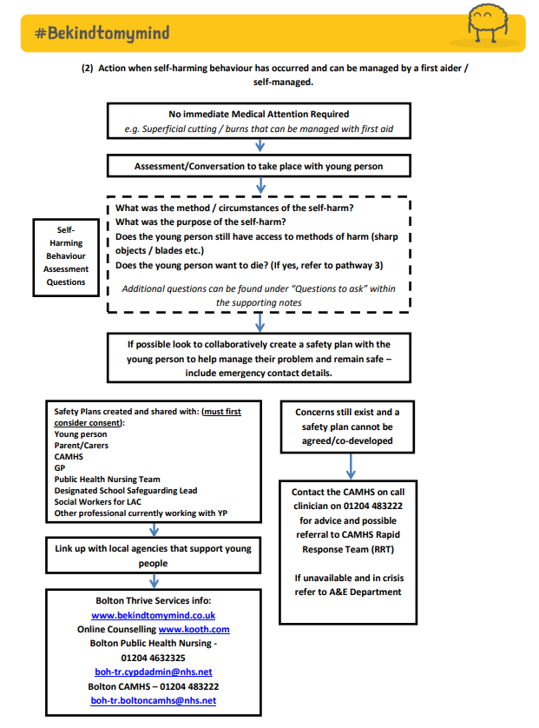
Self-harming Behaviour Pathway
Bolton CCG and Bolton CAMHS led on the development of a multi-agency self-harming behaviour pathway to support Bolton’s CYP Workforce
The document contains three scenario based pathways as well as guidance notes, templates and training opportunities
Engagement took place with Education Settings (Primary and Secondary) to ensure the pathway is fit for purpose and the pathway will be further reviewed in May 2021.
The pathway aims to provide consistency across the locality with regards to having conversations about self-harming behaviours and escalating need when required
Self-harming behaviour pathway
Click here to access free online suicide awareness training
(20 mins – Zero Suicide Alliance)

Slide 10
Additional Resources
Click here to download a one page overview of NHS approved apps for mental health (adults & children)
Every Mind Matters - https://www.nhs.uk/oneyou/every-mind-matters/
Created by Public Health England, with tips and advice developed with experts and approved by the NHS. Provides dedicated advice and support to young people, parents and carers.
Mental Health and Wellbeing Resources (Greater Manchester Health and Social Care Hub) - https://hub.gmhsc.org.uk/mental-health/covid-19-resources/
A range of free resources to support mental health and wellbeing with a particular focus on Covid-19. Includes a dedicated section on Children, Young People and Families.
Mental Heath Services in your area (Greater Manchester Health and Social Care Hub) - https://hub.gmhsc.org.uk/mental-health/in-your-area/
Provides a breakdown of mental health support (all age) in each of the 10 areas of Greater Manchester
Mind Ed for Families - https://mindedforfamilies.org.uk/young-people
Supports parents and those caring for children and young people in their family when they are concerned about a young person’s mental health or well-being.
MindEd (Professionals) - https://www.minded.org.uk/catalogue/TileView
MindEd is an online e-portal offering a range of free training modules about children and young people's mental health.
Living Life to The Full - https://www.gmhealthhub.org/feeling/living-life-to-the-full
Free of charge to residents in Greater Manchester, Living Life to the Full has a range of online course to improve feelings, beat stress and boost an individuals ability to live well. Printed copies are also available for free across libraries in Greater Manchester.
Resources for Schools and Colleges - https://www.annafreud.org/schools-and-colleges/resources/
A large range of downloadable resources for Education Settings from the developers of the Thrive model.
Young Minds - https://youngminds.org.uk/
An online resource to help young people look after their own mental health. The website also contains information and resources to Parents/Carers and also Professionals. A Parent/Carer Helpline is also available on 0808 802 5544

Slide 11
Pathways for young when they have been referred into CAMHS
How to access a full mental health assessment for YP who pose a potential risk to themselves / others to assess whether they should / shouldn’t be in school
What Schools can do to support young people under CAMHS

